Slide 1


Fundamentos Large Language Models (LLMs)

Slide 2
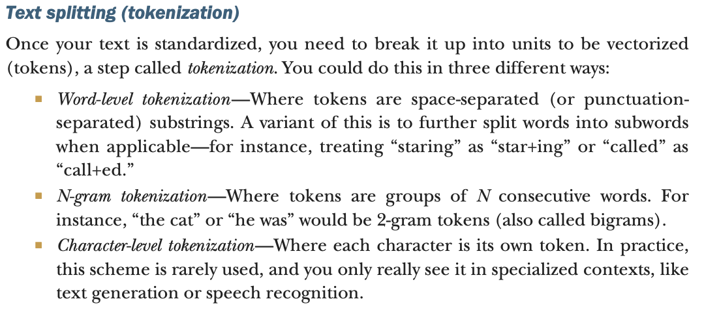
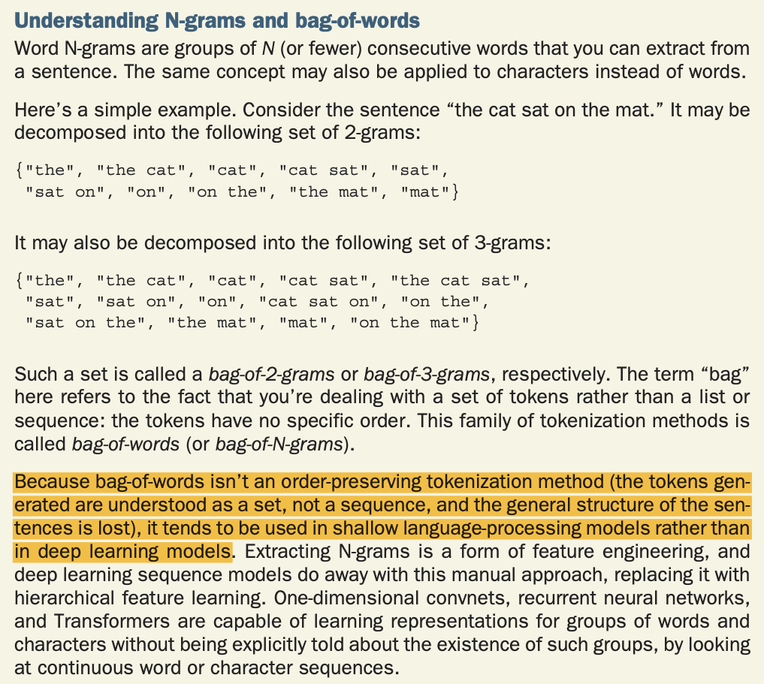
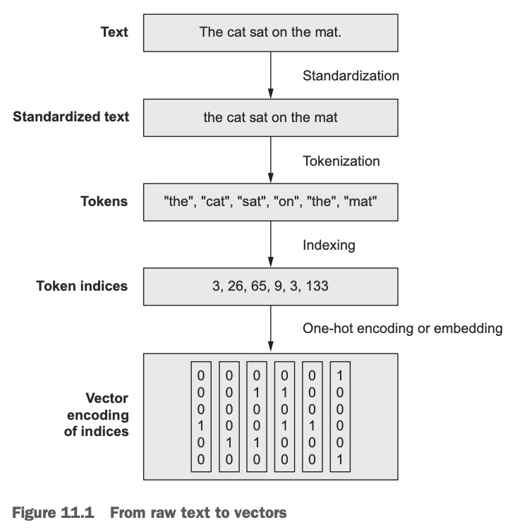
1. Procesado al texto de entrada
¿Cómo necesita ser procesado el texto de entrada a un modelo de lenguaje natural?

Slide 3
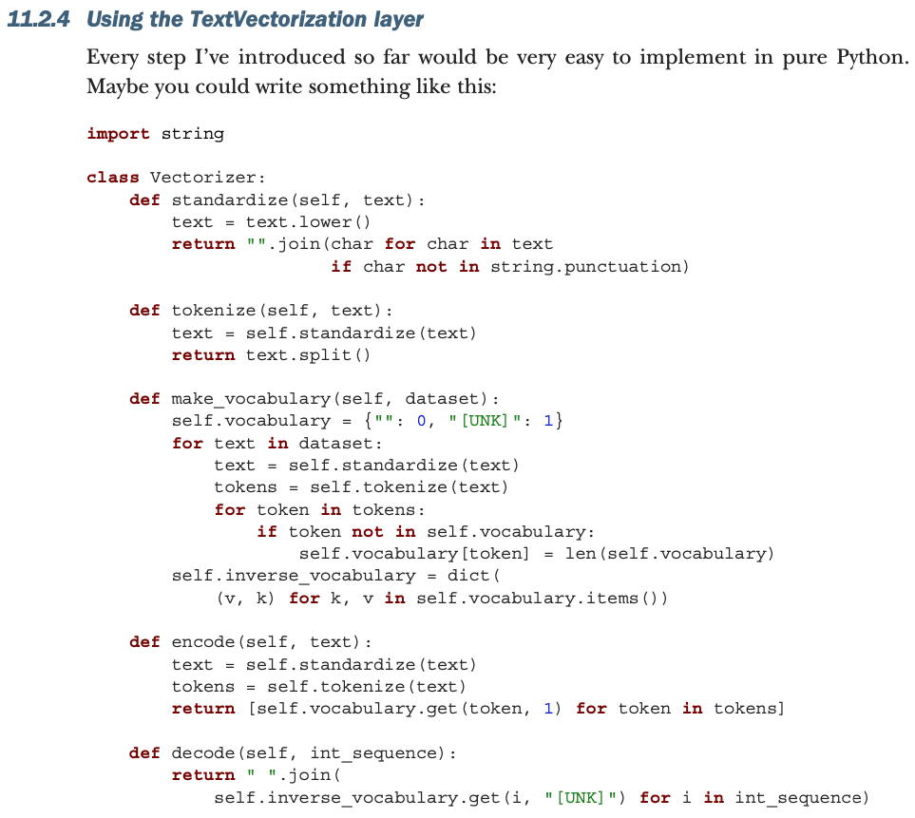
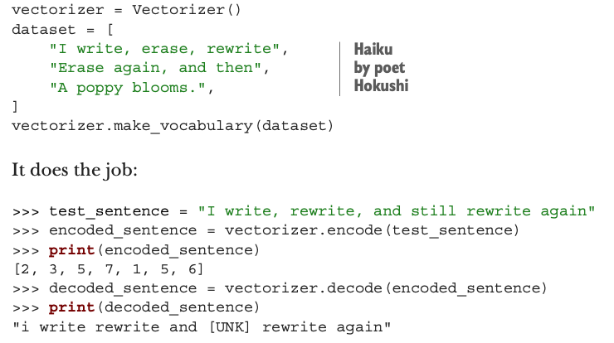
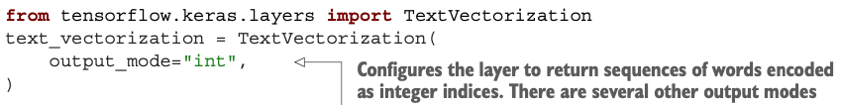

1. Procesado al texto de entrada
Código from scratch del vectorizador de
Keras (TextVectorization)

Slide 4
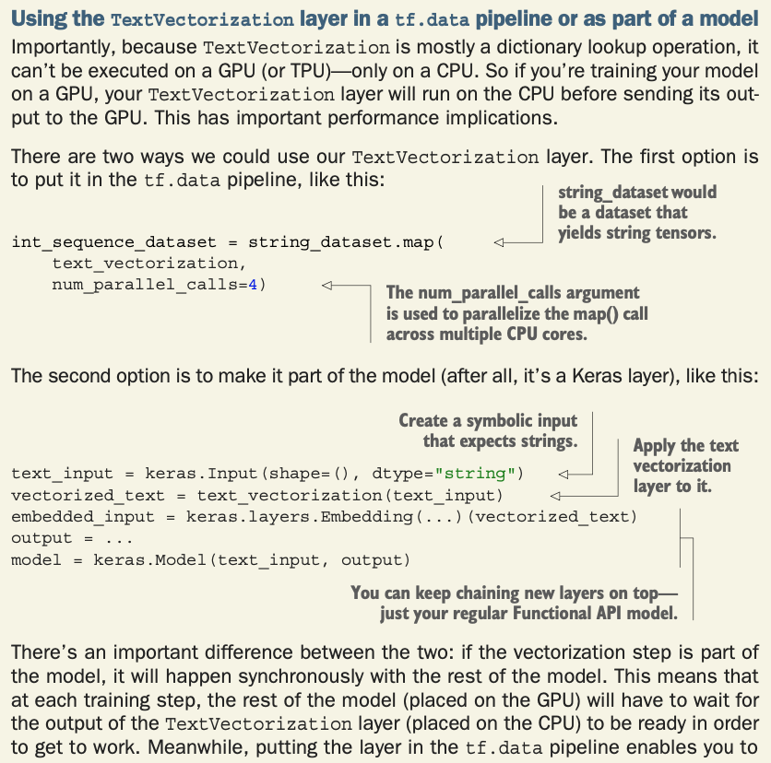
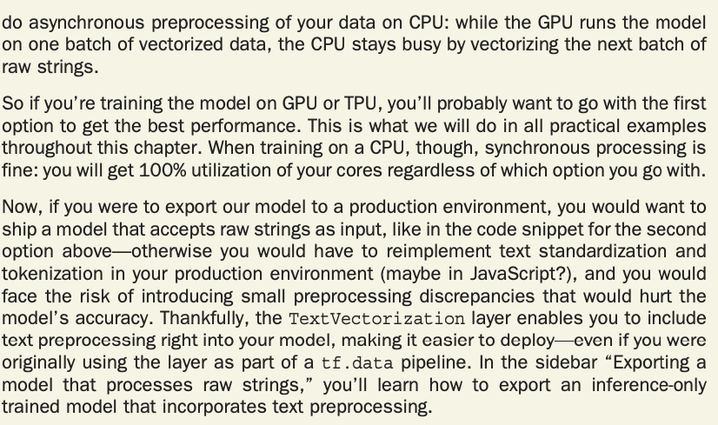
1. Procesado al texto de entrada

Slide 5
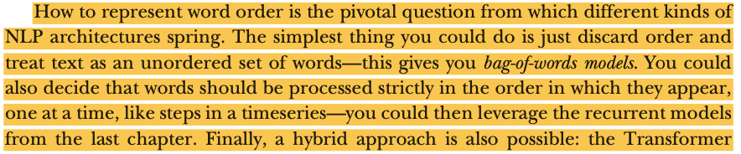
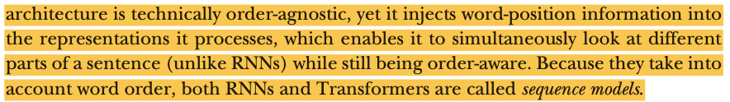
1. Procesado al texto de entrada

Slide 6
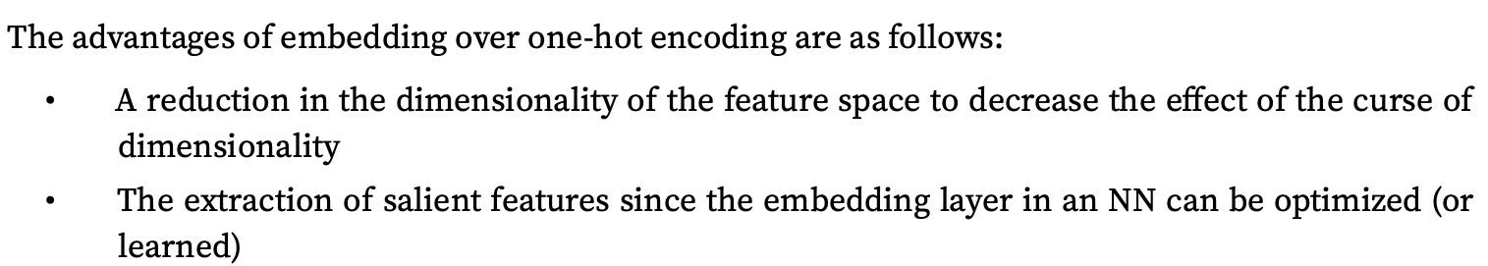
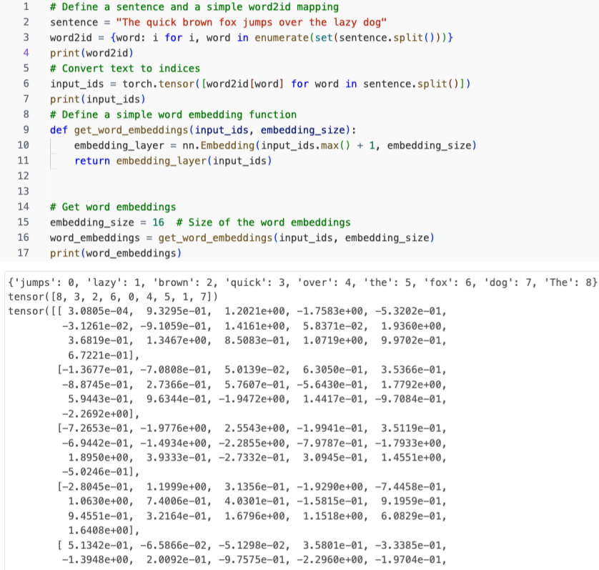
2. Embeddings de las palabras y codificación de la posición

Slide 7
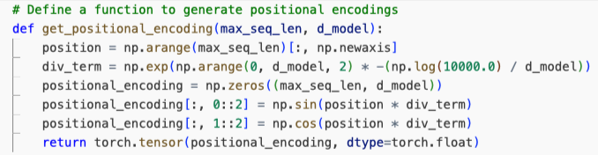
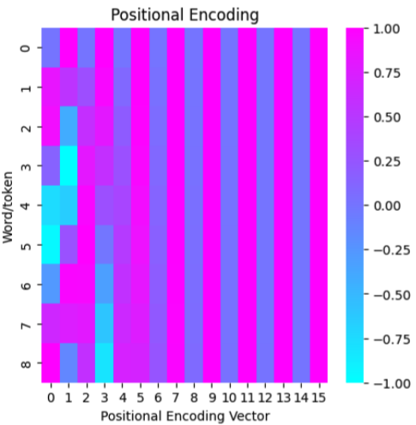
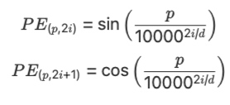
2. Embeddings de las palabras y codificación de la posición
By visualizing the positional encodings in a heatmap, we can see how these values change across positions and dimensions, and get an intuition for how the Transformer model might use these values to understand the order of words in the sequence.

Slide 8
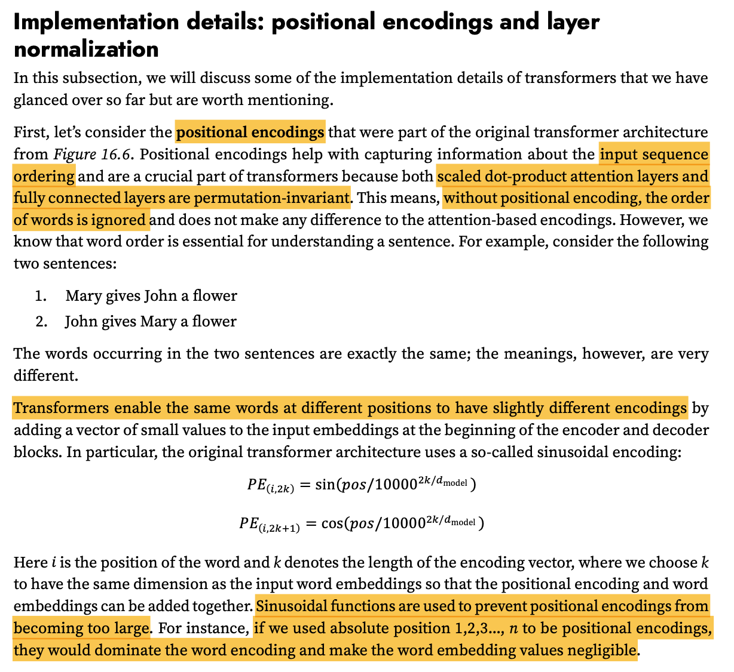
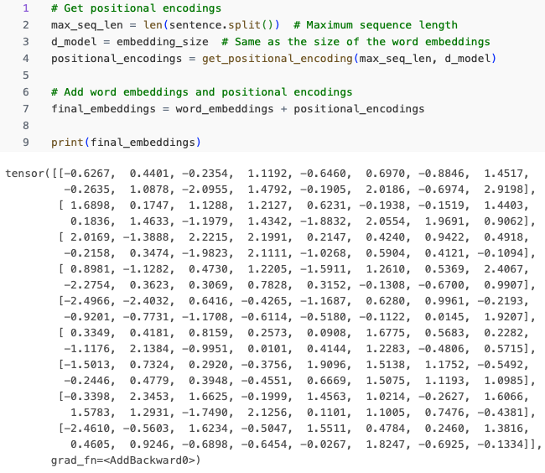
2. Embeddings de las palabras y codificación de la posición

Slide 9
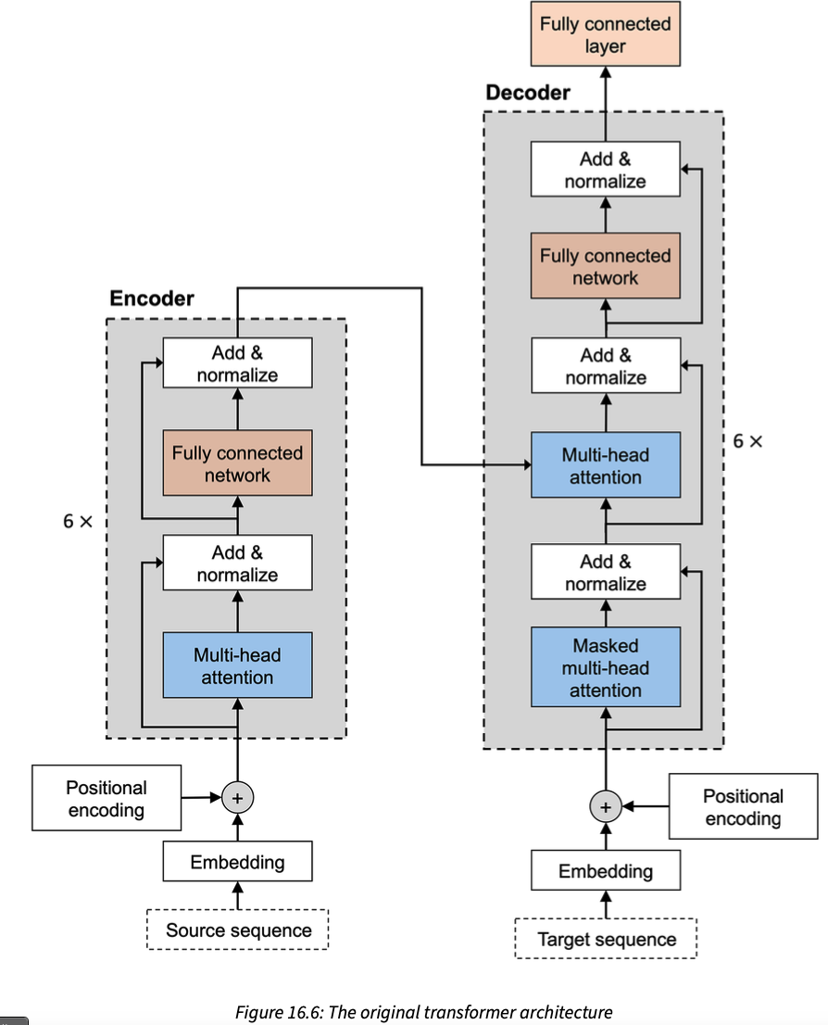
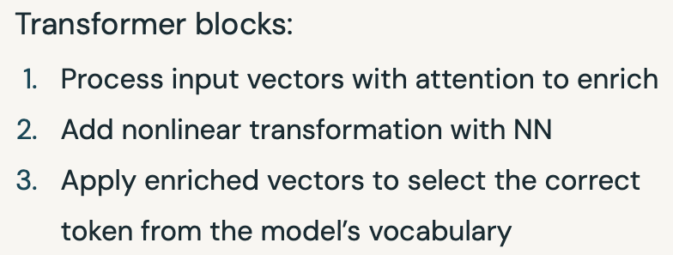
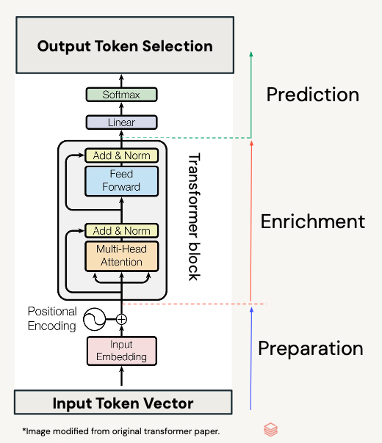
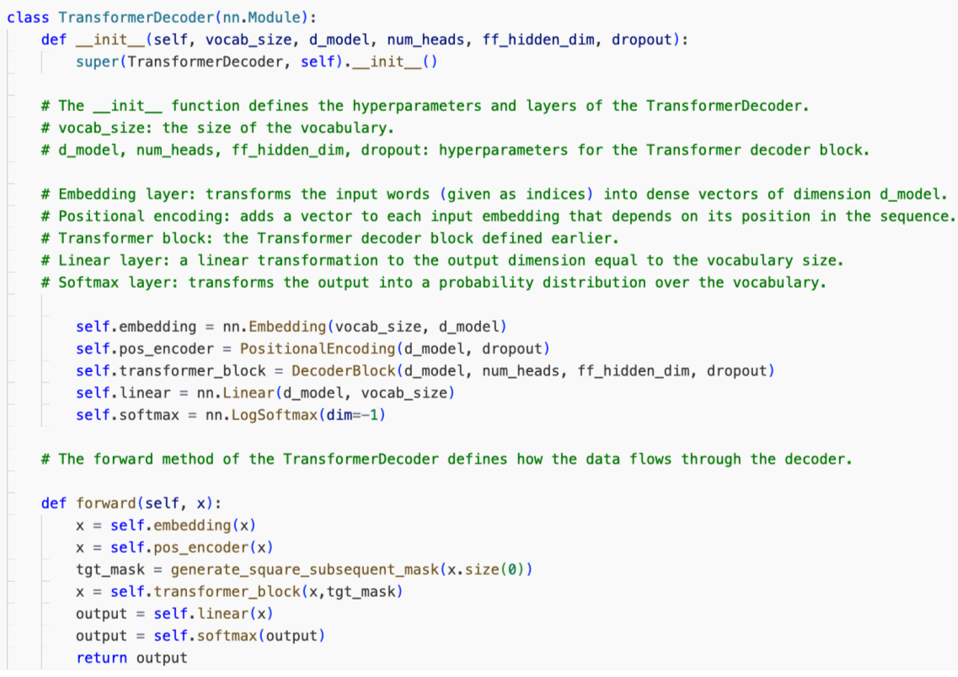
3. Transformer architecture

Slide 10
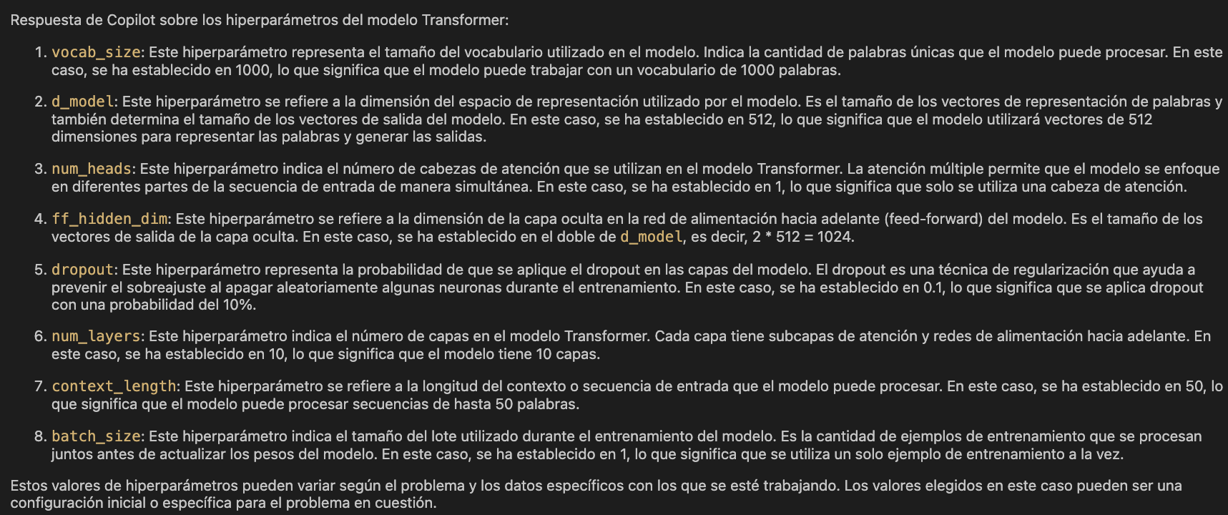

Slide 11
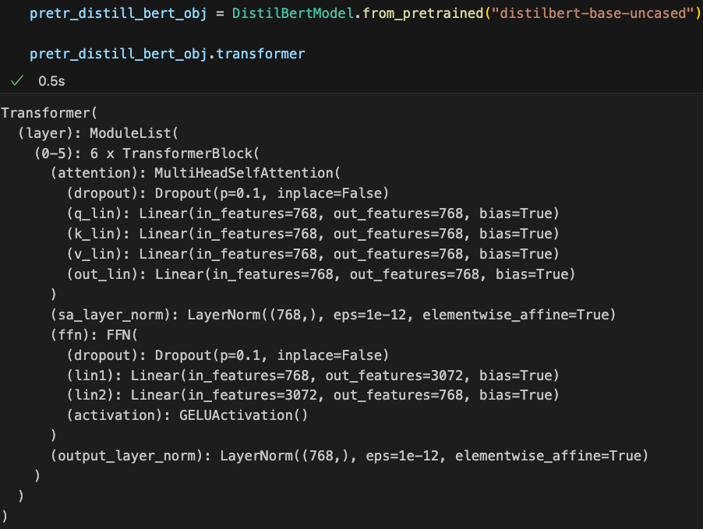
GermanCM: traduce esto a español: support the smoking customers against the onset of any cardio-respiratory diseases
GitHub Copilot: Apoyar a los clientes fumadores contra el inicio de cualquier enfermedad cardiorespiratoria.
GermanCM: quiero leer un pandas df sin index column
GitHub Copilot: Puedes utilizar el parámetro `index_col` al leer el archivo CSV para especificar que no deseas tener una columna de índice. Aquí tienes un ejemplo de cómo hacerlo:
```python
import pandas as pd
smoking_cust_df = pd.read_csv(r'data_sources/dataset_rea_mi.csv', sep=';', index_col=False)
smoking_cust_df.tail()
```
Esto leerá el archivo CSV sin asignar una columna de índice.
GermanCM: colorea de azul el texto seleccionado
GitHub Copilot: Lamentablemente, como un modelo de lenguaje de texto, no tengo la capacidad de realizar acciones de formato visual, como colorear texto. Mi función principal es proporcionar información y sugerencias relacionadas con la programación y el desarrollo. Sin embargo, puedes utilizar las funciones de formato de tu editor de texto o IDE para resaltar o colorear el texto seleccionado.
GermanCM: en markdown, pon colo a un texto
GitHub Copilot: En Markdown, puedes aplicar estilos de texto utilizando el formato de sintaxis adecuado. Para poner un texto en color, puedes utilizar el siguiente formato:
```markdown
<span style="color:blue">Texto en color azul</span>
```
Esto generará el siguiente resultado:
<span style="color:blue">Texto en color azul</span>
Recuerda que el soporte para estilos de texto puede variar dependiendo de la plataforma o aplicación que estés utilizando para visualizar el Markdown.
GermanCM: quiero crear un conda env a patir de otro
GitHub Copilot: Para crear un nuevo entorno conda basado en otro existente, puedes utilizar el siguiente comando:
```bash
conda create --name nuevo_entorno --clone entorno_existente
```
Reemplaza "nuevo_entorno" con el nombre que deseas darle al nuevo entorno y "entorno_existente" con el nombre del entorno que deseas clonar.
Por ejemplo, si deseas crear un nuevo entorno llamado "nuevo_env" basado en un entorno existente llamado "env_existente", puedes ejecutar el siguiente comando:
```bash
conda create --name nuevo_env --clone env_existente
```
Esto creará un nuevo entorno conda llamado "nuevo_env" que tendrá las mismas dependencias y configuraciones que el entorno existente "env_existente".
GermanCM: how can I display an HTML in VS CODE
GitHub Copilot: To display an HTML file in Visual Studio Code, you can use the built-in "Preview" feature. Here's how you can do it:
1. Open the HTML file in Visual Studio Code.
2. Right-click anywhere in the editor or on the file in the file explorer.
3. From the context menu, select "Open with Live Server" or "Open with Live Preview" (depending on the extensions you have installed).
4. A new browser window or tab will open, displaying the rendered HTML content.
If you don't have the "Live Server" or "Live Preview" extension installed, you can install it from the Visual Studio Code marketplace. Simply search for "Live Server" or "Live Preview" and follow the installation instructions.
Alternatively, you can also use the "Open in Default Browser" extension to open the HTML file directly in your default web browser. After installing the extension, right-click on the HTML file and select "Open in Default Browser" from the context menu.
These extensions provide a convenient way to preview and interact with HTML files directly within Visual Studio Code.
GermanCM: can I ask the ydata_profiling library to include box plots in the report?
GitHub Copilot: Yes, you can ask the `ydata_profiling` library to include box plots in the report. The `ydata_profiling` library provides various options and configurations to customize the generated report.
To include box plots in the report, you can use the `plot` parameter of the `ProfileReport` function. Set the `plot` parameter to `"box"` to include box plots in the report.
Here's an example of how you can generate a report with box plots using `ydata_profiling`:
```python
from pandas_profiling import ProfileReport
# Assuming you have a DataFrame called 'df'
profile = ProfileReport(df, title='Pandas Profiling Report', explorative=True, plot={'histogram': {'bins': 20}, 'box': {'whisker_color': '#7570b3'}})
profile.to_file("report.html")
```
In the above example, the `plot` parameter is set to include both histograms and box plots in the report. You can customize the appearance of the box plots by providing additional options within the `plot` parameter.
Make sure you have the `ydata_profiling` library installed in your environment before using it. You can install it using `pip install ydata_profiling`.
GermanCM: como puedo sibrayar texto en markdown
GitHub Copilot: En Markdown, puedes resaltar o subrayar texto utilizando el formato de sintaxis adecuado. Para subrayar texto, puedes utilizar el siguiente formato:
```markdown
<u>Texto subrayado</u>
```
Esto generará el siguiente resultado:
<u>Texto subrayado</u>
Recuerda que el soporte para estilos de texto puede variar dependiendo de la plataforma o aplicación que estés utilizando para visualizar el Markdown. No todos los visores de Markdown admiten el subrayado de texto.
GermanCM: cómo puedo otener, con numpy, los valores mínimo, máximo, quartiles y rango intercuartílico? Preferiblemente con una sola función
GitHub Copilot: Puedes utilizar la función `numpy.percentile()` para obtener los valores mínimo, máximo, quartiles y rango intercuartílico en una sola llamada. Aquí tienes un ejemplo de cómo hacerlo:
```python
import numpy as np
# Supongamos que tienes un array llamado 'data'
data = np.array([1, 2, 3, 4, 5, 6, 7, 8, 9, 10])
# Calcula los valores mínimo, máximo, quartiles y rango intercuartílico
min_value = np.min(data)
max_value = np.max(data)
quartiles = np.percentile(data, [25, 50, 75])
iqr = quartiles[2] - quartiles[0]
print("Valor mínimo:", min_value)
print("Valor máximo:", max_value)
print("Quartiles:", quartiles)
print("Rango intercuartílico:", iqr)
```
Esto imprimirá los valores mínimo, máximo, quartiles y rango intercuartílico del array `data`. Asegúrate de tener la biblioteca NumPy instalada en tu entorno antes de ejecutar este código. Puedes instalarla utilizando `pip install numpy`.
GermanCM: pero quiero que uses np.percentile
GitHub Copilot: Mis disculpas por la confusión anterior. Puedes utilizar la función `np.percentile()` de NumPy para obtener los valores mínimo, máximo, quartiles y rango intercuartílico en una sola llamada. Aquí tienes un ejemplo actualizado:
```python
import numpy as np
# Supongamos que tienes un array llamado 'data'
data = np.array([1, 2, 3, 4, 5, 6, 7, 8, 9, 10])
# Calcula los valores mínimo, máximo, quartiles y rango intercuartílico
min_value, max_value = np.min(data), np.max(data)
quartiles = np.percentile(data, [25, 50, 75])
iqr = np.subtract(*np.percentile(data, [75, 25]))
print("Valor mínimo:", min_value)
print("Valor máximo:", max_value)
print("Quartiles:", quartiles)
print("Rango intercuartílico:", iqr)
```
En este ejemplo, utilizamos `np.percentile()` dos veces para calcular el rango intercuartílico. La función `np.subtract()` se utiliza para restar los valores del tercer y primer cuartil y obtener el rango intercuartílico. Esto imprimirá los valores mínimo, máximo, quartiles y rango intercuartílico del array `data`. Asegúrate de tener la biblioteca NumPy instalada en tu entorno antes de ejecutar este código. Puedes instalarla utilizando `pip install numpy`.
GermanCM: generate a docstring
GitHub Copilot: ```python
def get_descriptive_stats(self):
"""
Calculate and return descriptive statistics of the DataFrame.
Returns:
pandas.DataFrame: A DataFrame containing descriptive statistics such as count, mean,
standard deviation, minimum, quartiles, and maximum.
"""
return self.df.describe()
```
This docstring provides a brief description of the `get_descriptive_stats` function and its return value. It mentions that the function calculates and returns descriptive statistics of the DataFrame, including count, mean, standard deviation, minimum, quartiles, and maximum.
GermanCM: include it in a try catch
GitHub Copilot: Certainly! Here's an updated version of the code with a try-except block:
```python
def get_descriptive_stats(self):
try:
"""
Calculate and return descriptive statistics of the DataFrame.
Returns:
pandas.DataFrame: A DataFrame containing descriptive statistics such as count, mean,
standard deviation, minimum, quartiles, and maximum.
"""
return self.df.describe()
except Exception as e:
print(f"An error occurred: {str(e)}")
```
In this version, the `get_descriptive_stats` function is wrapped in a try-except block. If an exception occurs during the execution of the code inside the try block, it will be caught by the except block. The exception message will be printed to the console using `print(f"An error occurred: {str(e)}")`. You can modify the except block to handle the exception in a way that suits your needs.
GermanCM: include it in a try catch and add a docstring
GitHub Copilot: Certainly! Here's an updated version of the code with a try-except block and a docstring:
```python
def profile_dataframe(dataframe, dir_name):
"""
Generate a statistical report for the given DataFrame and save it to a specified directory.
Args:
dataframe (pandas.DataFrame): The DataFrame to be profiled.
dir_name (str): The directory path where the report will be saved.
Returns:
None
"""
try:
import ydata_profiling as pp
profile = pp.ProfileReport(dataframe, title='Dataset statistical report', explorative=True,
plot={'histogram': {'bins': 20}, 'box': {'whisker_color': '#7570b3'}})
profile.to_file(output_file=dir_name)
except Exception as e:
print(f"An error occurred: {str(e)}")
```
In this version, the `profile_dataframe` function is wrapped in a try-except block. If an exception occurs during the execution of the code inside the try block, it will be caught by the except block. The exception message will be printed to the console using `print(f"An error occurred: {str(e)}")`. The function takes a DataFrame and a directory path as arguments and generates a statistical report using the `ydata_profiling` library. The report is saved to the specified directory.
GermanCM: now, given the smoking_cust_df, generate an XGB model for me, applying grid search cross validation
GitHub Copilot: Certainly! Here's an example of how you can generate an XGBoost model using grid search cross-validation with the `smoking_cust_df` dataset:
```python
import pandas as pd
import xgboost as xgb
from sklearn.model_selection import GridSearchCV, train_test_split
from sklearn.metrics import accuracy_score
# Assuming 'smoking_cust_df' is your DataFrame with features and target variable
# Split the data into features and target variable
X = smoking_cust_df.drop('target', axis=1)
y = smoking_cust_df['target']
# Split the data into training and testing sets
X_train, X_test, y_train, y_test = train_test_split(X, y, test_size=0.2, random_state=42)
# Define the parameter grid for grid search
param_grid = {
'max_depth': [3, 5, 7],
'learning_rate': [0.1, 0.01, 0.001],
'n_estimators': [100, 500, 1000]
}
# Create the XGBoost classifier
xgb_model = xgb.XGBClassifier()
# Perform grid search cross-validation
grid_search = GridSearchCV(estimator=xgb_model, param_grid=param_grid, cv=5, scoring='accuracy')
grid_search.fit(X_train, y_train)
# Get the best parameters and best score
best_params = grid_search.best_params_
best_score = grid_search.best_score_
# Train the model with the best parameters
best_model = xgb.XGBClassifier(**best_params)
best_model.fit(X_train, y_train)
# Make predictions on the test set
y_pred = best_model.predict(X_test)
# Calculate accuracy score
accuracy = accuracy_score(y_test, y_pred)
print("Best parameters:", best_params)
print("Best score:", best_score)
print("Accuracy:", accuracy)
```
In this example, we first split the data into features (`X`) and the target variable (`y`). Then, we split the data into training and testing sets using `train_test_split()`. We define a parameter grid for the grid search, specifying different values for `max_depth`, `learning_rate`, and `n_estimators`. We create an XGBoost classifier and perform grid search cross-validation using `GridSearchCV()`. After obtaining the best parameters and best score, we train the model with the best parameters and make predictions on the test set. Finally, we calculate the accuracy score and print the results.
Make sure you have the necessary libraries (`pandas`, `xgboost`, `sklearn`) installed in your environment before running this code. You can install them using `pip install pandas xgboost scikit-learn`.
GermanCM: include this code into a class dedicated to train and evaluate
GitHub Copilot: Certainly! Here's an example of how you can encapsulate the code into a class dedicated to training and evaluating an XGBoost model:
```python
import pandas as pd
import xgboost as xgb
from sklearn.model_selection import GridSearchCV, train_test_split
from sklearn.metrics import roc_auc_score
class XGBoostTrainer:
def __init__(self, param_grid):
self.param_grid = param_grid
self.best_params = None
self.best_score = None
self.best_model = None
def train(self, X, y):
# Split the data into training and testing sets
X_train, X_test, y_train, y_test = train_test_split(X, y, test_size=0.2, random_state=42)
# Create the XGBoost classifier
xgb_model = xgb.XGBClassifier()
# Perform grid search cross-validation
grid_search = GridSearchCV(estimator=xgb_model, param_grid=self.param_grid, cv=5, scoring='roc_auc')
grid_search.fit(X_train, y_train)
# Get the best parameters and best score
self.best_params = grid_search.best_params_
self.best_score = grid_search.best_score_
# Train the model with the best parameters
self.best_model = xgb.XGBClassifier(**self.best_params)
self.best_model.fit(X_train, y_train)
# Make predictions on the test set
y_pred = self.best_model.predict(X_test)
# Calculate AUC score
auc_score = roc_auc_score(y_test, y_pred)
return auc_score
def get_best_params(self):
return self.best_params
def get_best_score(self):
return self.best_score
def get_best_model(self):
return self.best_model
# Assuming 'smoking_cust_df' is your DataFrame with features and target variable
X = smoking_cust_df.drop('label', axis=1)
y = smoking_cust_df['label']
# Define the parameter grid for grid search
param_grid = {
'max_depth': [3, 5, 7],
'learning_rate': [0.1, 0.01, 0.001],
'n_estimators': [100, 500, 1000]
}
# Create an instance of the XGBoostTrainer class
trainer = XGBoostTrainer(param_grid)
# Train the model and get the AUC score
auc_score = trainer.train(X, y)
# Get the best parameters and best score
best_params = trainer.get_best_params()
best_score = trainer.get_best_score()
print("Best parameters:", best_params)
print("Best score:", best_score)
print("AUC:", auc_score)
```
In this example, the code is encapsulated within the `XGBoostTrainer` class. The `train` method takes the features (`X`) and target variable (`y`) as input, performs grid search cross-validation, trains the model with the best parameters, and returns the AUC score. The best parameters, best score, and best model can be accessed using the `get_best_params`, `get_best_score`, and `get_best_model` methods, respectively. Finally, an instance of the `XGBoostTrainer` class is created, and the model is trained and evaluated. The best parameters, best score, and AUC score are printed to the console.
GermanCM: and now, please build the same grid search cross validation model pipeline with SVM classifier from scikit learn
GitHub Copilot: Certainly! Here's an example of how you can build a grid search cross-validation model pipeline with an SVM classifier from scikit-learn:
```python
import pandas as pd
from sklearn.svm import SVC
from sklearn.model_selection import GridSearchCV, train_test_split
from sklearn.metrics import accuracy_score
class SVMTrainer:
def __init__(self, param_grid):
self.param_grid = param_grid
self.best_params = None
self.best_score = None
self.best_model = None
def train(self, X, y):
# Split the data into training and testing sets
X_train, X_test, y_train, y_test = train_test_split(X, y, test_size=0.2, random_state=42)
# Create the SVM classifier
svm_model = SVC()
# Perform grid search cross-validation
grid_search = GridSearchCV(estimator=svm_model, param_grid=self.param_grid, cv=5, scoring='accuracy')
grid_search.fit(X_train, y_train)
# Get the best parameters and best score
self.best_params = grid_search.best_params_
self.best_score = grid_search.best_score_
# Train the model with the best parameters
self.best_model = SVC(**self.best_params)
self.best_model.fit(X_train, y_train)
# Make predictions on the test set
y_pred = self.best_model.predict(X_test)
# Calculate accuracy score
accuracy = accuracy_score(y_test, y_pred)
return accuracy
def get_best_params(self):
return self.best_params
def get_best_score(self):
return self.best_score
def get_best_model(self):
return self.best_model
# Assuming 'smoking_cust_df' is your DataFrame with features and target variable
X = smoking_cust_df.drop('label', axis=1)
y = smoking_cust_df['label']
# Define the parameter grid for grid search
param_grid = {
'C': [0.1, 1, 10],
'kernel': ['linear', 'rbf', 'poly'],
'gamma': ['scale', 'auto']
}
# Create an instance of the SVMTrainer class
trainer = SVMTrainer(param_grid)
# Train the model and get the accuracy score
accuracy = trainer.train(X, y)
# Get the best parameters and best score
best_params = trainer.get_best_params()
best_score = trainer.get_best_score()
print("Best parameters:", best_params)
print("Best score:", best_score)
print("Accuracy:", accuracy)
```
In this example, the code is encapsulated within the `SVMTrainer` class. The `train` method takes the features (`X`) and target variable (`y`) as input, performs grid search cross-validation, trains the model with the best parameters, and returns the accuracy score. The best parameters, best score, and best model can be accessed using the `get_best_params`, `get_best_score`, and `get_best_model` methods, respectively. Finally, an instance of the `SVMTrainer` class is created, and the model is trained and evaluated. The best parameters, best score, and accuracy score are printed to the console.
Make sure you have the necessary libraries (`pandas`, `scikit-learn`) installed in your environment before running this code. You can install them using `pip install pandas scikit-learn`.
GermanCM: include try catch and dpcstrings
GitHub Copilot: Certainly! Here's an updated version of the code with try-except blocks and docstrings added:
```python
import pandas as pd
from sklearn.svm import SVC
from sklearn.model_selection import GridSearchCV, train_test_split
from sklearn.metrics import roc_auc_score
class ModelTrainer:
"""
A class for training models using grid search cross-validation.
"""
def __init__(self, param_grid):
"""
Initialize the ModelTrainer object.
Parameters:
- param_grid (dict): The parameter grid for grid search.
"""
self.param_grid = param_grid
self.best_params = None
self.best_score = None
self.best_model = None
def svm_trainer(self, X, y):
"""
Train an SVM model using grid search cross-validation.
Parameters:
- X (array-like): The input features.
- y (array-like): The target variable.
Returns:
- float: The ROC AUC score of the trained model.
"""
try:
# Split the data into training and testing sets
X_train, X_test, y_train, y_test = train_test_split(X, y, test_size=0.2, random_state=42)
# Create the SVM classifier
svm_model = SVC()
# Perform grid search cross-validation
grid_search = GridSearchCV(estimator=svm_model, param_grid=self.param_grid, cv=5, scoring='roc_auc')
grid_search.fit(X_train, y_train)
# Get the best parameters and best score
self.best_params = grid_search.best_params_
self.best_score = grid_search.best_score_
# Train the model with the best parameters
self.best_model = SVC(**self.best_params)
self.best_model.fit(X_train, y_train)
# Make predictions on the test set
y_pred = self.best_model.predict(X_test)
# Calculate ROC AUC score
auc_score = roc_auc_score(y_test, y_pred)
return auc_score
except Exception as e:
print("An error occurred during SVM training:", str(e))
def get_best_params(self):
"""
Get the best parameters found during training.
Returns:
- dict: The best parameters.
"""
return self.best_params
def get_best_score(self):
"""
Get the best score found during training.
Returns:
- float: The best score.
"""
return self.best_score
def get_best_model(self):
"""
Get the best model found during training.
Returns:
- object: The best model.
"""
return self.best_model
```
In this updated code, try-except blocks are added to catch any exceptions that may occur during the training process. If an exception is caught, an error message is printed to the console. Docstrings are also added to provide documentation for the class and its methods, describing their purpose, parameters, and return values.
Please note that the code provided is just an example and may need to be adapted to fit your specific use case.
GermanCM: explain this code: SVC(**self.best_params)
GitHub Copilot: The code `SVC(**self.best_params)` is creating an instance of the `SVC` class from scikit-learn's support vector machine (SVM) module. It uses the `**` operator to unpack the contents of the `self.best_params` dictionary as keyword arguments.
In scikit-learn, the `SVC` class represents a support vector machine classifier. It is used for classification tasks and can handle both linear and non-linear classification problems.
By passing the `**self.best_params` argument, the code sets the parameters of the `SVC` instance to the values stored in the `self.best_params` dictionary. These parameters are determined through grid search cross-validation, where different combinations of parameter values are evaluated to find the best performing model.
The `self.best_params` dictionary typically contains key-value pairs representing the hyperparameters of the SVM model. Hyperparameters are parameters that are set before the learning process begins and affect the behavior of the model. Examples of hyperparameters for an SVM classifier include the regularization parameter `C`, the kernel type `kernel`, and the kernel coefficient `gamma`.
By setting the parameters of the `SVC` instance to the best parameter values found during grid search cross-validation, the code ensures that the SVM model is trained with the optimal hyperparameter settings. This can lead to improved performance and better generalization on unseen data.
Overall, `SVC(**self.best_params)` is a concise way to create an `SVC` instance with the best parameter values obtained through grid search cross-validation.
GermanCM: dime la manera más efectiva de encontrar las columnas con missing values
GitHub Copilot: Una forma efectiva de encontrar las columnas con valores faltantes (missing values) en un DataFrame es utilizando el método `isna()` de pandas. Este método devuelve un DataFrame booleano con el mismo tamaño que el DataFrame original, donde cada celda contiene `True` si el valor es faltante y `False` en caso contrario.
Para encontrar las columnas con valores faltantes, puedes utilizar el método `any()` en combinación con `isna()`. El método `any()` devuelve `True` si al menos uno de los elementos en el eje especificado es `True`, y `False` en caso contrario. Al aplicar `any()` en el eje de las columnas (`axis=0`), obtendrás un Series booleano que indica qué columnas tienen al menos un valor faltante.
Aquí tienes un ejemplo de cómo encontrar las columnas con valores faltantes en un DataFrame llamado `smoking_cust_df`:
```python
import pandas as pd
# Utilizar el método isna() para encontrar los valores faltantes
missing_values = smoking_cust_df.isna()
# Utilizar el método any() en el eje de las columnas para encontrar las columnas con valores faltantes
columns_with_missing_values = missing_values.any(axis=0)
# Obtener el nombre de las columnas con valores faltantes
columns = columns_with_missing_values[columns_with_missing_values].index.tolist()
# Imprimir las columnas con valores faltantes
print("Columnas con valores faltantes:")
print(columns)
```
Este código imprimirá las columnas con valores faltantes en el DataFrame `smoking_cust_df`. Puedes adaptar este código según tus necesidades y el nombre de tu DataFrame.
GermanCM: dame el código para aplicar imputer con median de scikit
GitHub Copilot: Para aplicar el imputador con la mediana utilizando scikit-learn, puedes utilizar la clase `SimpleImputer` del módulo `sklearn.impute`. Aquí tienes un ejemplo de cómo aplicar el imputador con la mediana a las columnas con valores faltantes en un DataFrame llamado `smoking_cust_df`:
```python
from sklearn.impute import SimpleImputer
# Crear el imputador con la estrategia de la mediana
imputer = SimpleImputer(strategy='median')
# Obtener las columnas con valores faltantes
columns_with_missing_values = smoking_cust_df.columns[smoking_cust_df.isna().any()].tolist()
# Aplicar el imputador a las columnas con valores faltantes
smoking_cust_df[columns_with_missing_values] = imputer.fit_transform(smoking_cust_df[columns_with_missing_values])
```
En este código, se crea una instancia de `SimpleImputer` con la estrategia `'median'`, que reemplaza los valores faltantes con la mediana de cada columna. Luego, se obtienen las columnas con valores faltantes utilizando `smoking_cust_df.columns[smoking_cust_df.isna().any()]`, que devuelve una lista de las columnas que tienen al menos un valor faltante. Finalmente, se aplica el imputador a las columnas seleccionadas utilizando `imputer.fit_transform(smoking_cust_df[columns_with_missing_values])`, que ajusta el imputador a los datos y transforma las columnas con valores faltantes utilizando la mediana.
Recuerda que debes adaptar este código según tus necesidades y el nombre de tu DataFrame. Además, asegúrate de tener scikit-learn instalado en tu entorno antes de ejecutar este código. Puedes instalarlo utilizando `pip install scikit-learn`.
GermanCM: aplícalo a un dataset de ejemplo de 10filas
GitHub Copilot: Aquí tienes un ejemplo de cómo aplicar la función `impute_missing_vals` a un dataset de ejemplo con 10 filas:
```python
import pandas as pd
# Crear un DataFrame de ejemplo con valores faltantes
data = {'A': [1, 2, None, 4, 5, None, 7, 8, 9, 10],
'B': [11, None, 13, 14, None, 16, 17, 18, None, 20],
'C': [21, 22, 23, None, 25, 26, None, 28, 29, 30]}
df = pd.DataFrame(data)
# Definir la función para imputar valores faltantes
def impute_missing_vals(df):
from sklearn.impute import SimpleImputer
# Crear el imputador con la estrategia de la mediana
imputer = SimpleImputer(strategy='median')
# Obtener las columnas con valores faltantes
columns_with_missing_values = df.columns[df.isna().any()].tolist()
# Aplicar el imputador a las columnas con valores faltantes
df[columns_with_missing_values] = imputer.fit_transform(df[columns_with_missing_values])
return df
# Aplicar la función al DataFrame de ejemplo
imputed_df = impute_missing_vals(df)
# Imprimir el DataFrame resultante
print(imputed_df)
```
Este código crea un DataFrame de ejemplo con 10 filas y algunas celdas con valores faltantes. Luego, se aplica la función `impute_missing_vals` al DataFrame para imputar los valores faltantes utilizando la estrategia de la mediana. El DataFrame resultante, con los valores faltantes imputados, se almacena en la variable `imputed_df` y se imprime en la consola.
Recuerda que puedes adaptar este código según tus necesidades y el nombre de tu DataFrame.
GermanCM: ahora indica un código con el que acceder a las feature importances de XGB
GitHub Copilot: Para acceder a las importancias de las características (feature importances) en XGBoost, puedes utilizar el atributo `feature_importances_` del modelo entrenado. Aquí tienes un ejemplo de cómo acceder a las importancias de las características en XGBoost:
```python
import xgboost as xgb
# Entrenar el modelo XGBoost
model = xgb.XGBClassifier()
model.fit(X_train, y_train)
# Obtener las importancias de las características
importances = model.feature_importances_
# Crear un DataFrame con las importancias y los nombres de las características
feature_importances = pd.DataFrame({'Feature': X_train.columns, 'Importance': importances})
# Ordenar las importancias de forma descendente
feature_importances = feature_importances.sort_values('Importance', ascending=False)
# Imprimir las importancias de las características
print(feature_importances)
```
En este ejemplo, se entrena un modelo XGBoost utilizando `xgb.XGBClassifier()`. Luego, se accede a las importancias de las características utilizando `model.feature_importances_`, que devuelve un array con las importancias de las características. Estas importancias se almacenan en un DataFrame llamado `feature_importances`, junto con los nombres de las características.
Después, se ordenan las importancias de forma descendente utilizando `feature_importances.sort_values('Importance', ascending=False)`. Finalmente, se imprime el DataFrame `feature_importances` que muestra las importancias de las características en orden descendente.
Recuerda que debes adaptar este código según tus necesidades y el nombre de tu modelo y datos. Además, asegúrate de tener la biblioteca XGBoost instalada en tu entorno antes de ejecutar este código. Puedes instalarlo utilizando `pip install xgboost`.
GermanCM: y cómo puedo usar shap library para obterner los shapley values de cada predicción?
GitHub Copilot: Para utilizar la biblioteca SHAP y obtener los valores de Shapley de cada predicción en un modelo entrenado, puedes seguir estos pasos:
1. Instalar la biblioteca SHAP si aún no lo has hecho. Puedes instalarla utilizando `pip install shap`.
2. Importar las bibliotecas necesarias:
```python
import shap
import xgboost as xgb
```
3. Entrenar tu modelo XGBoost y obtener las predicciones:
```python
# Entrenar el modelo XGBoost
model = xgb.XGBClassifier()
model.fit(X_train, y_train)
# Obtener las predicciones
predictions = model.predict(X_test)
```
4. Crear un objeto `explainer` utilizando el modelo entrenado y los datos de entrenamiento:
```python
explainer = shap.Explainer(model, X_train)
```
5. Calcular los valores de Shapley para cada predicción utilizando el objeto `explainer`:
```python
shap_values = explainer.shap_values(X_test)
```
6. Puedes acceder a los valores de Shapley para una predicción específica utilizando el índice correspondiente:
```python
# Obtener los valores de Shapley para la primera predicción
shap_values_pred_0 = shap_values[0]
```
7. También puedes visualizar los valores de Shapley utilizando los gráficos de SHAP:
```python
# Visualizar los valores de Shapley para la primera predicción
shap.force_plot(explainer.expected_value, shap_values_pred_0, X_test.iloc[0])
```
Recuerda que debes adaptar este código según tus necesidades y el nombre de tu modelo y datos. Además, asegúrate de tener la biblioteca SHAP instalada en tu entorno antes de ejecutar este código.
GermanCM: how to disable future warnings
GitHub Copilot: To disable future warnings in Python, you can use the `warnings` module. Here's an example of how to disable future warnings:
```python
import warnings
# Disable future warnings
warnings.simplefilter(action='ignore', category=FutureWarning)
```
In this example, we import the `warnings` module and use the `simplefilter` function to ignore future warnings. The `action='ignore'` parameter tells Python to ignore the warnings, and the `category=FutureWarning` parameter specifies that we want to ignore future warnings specifically.
You can place this code at the beginning of your script or notebook to disable future warnings throughout your code. However, keep in mind that disabling warnings may hide important information, so use it with caution. It's generally recommended to address the underlying issues causing the warnings instead of suppressing them.
GermanCM: cómo puedo arreglar esto: "Visualization omitted, Javascript library not loaded!
Have you run `initjs()` in this notebook? If this notebook was from another user you must also trust this notebook (File -> Trust notebook). If you are viewing this notebook on github the Javascript has been stripped for security. If you are using JupyterLab this error is because a JupyterLab extension has not yet been written."
GitHub Copilot: El mensaje de error indica que no se ha cargado la biblioteca de JavaScript necesaria para visualizar el gráfico de SHAP en el entorno actual. Hay algunas soluciones posibles que puedes intentar:
1. Ejecutar `initjs()` en la celda antes de generar la visualización. Esto debería cargar la biblioteca de JavaScript necesaria. Asegúrate de que la celda que contiene `initjs()` se ejecute antes de la celda que genera la visualización.
2. Si estás utilizando Jupyter Notebook, verifica si has confiado en el notebook. Ve a "File" -> "Trust notebook" para confiar en el notebook actual. Esto puede ser necesario si el notebook fue creado por otro usuario.
3. Si estás visualizando el notebook en GitHub, es posible que la biblioteca de JavaScript haya sido eliminada por motivos de seguridad. En este caso, no podrás ver la visualización en GitHub. Puedes intentar ejecutar el notebook en tu propio entorno local para ver la visualización correctamente.
4. Si estás utilizando JupyterLab, es posible que no haya una extensión de JupyterLab disponible para mostrar la visualización de SHAP. En este caso, puedes intentar ejecutar el notebook en Jupyter Notebook en su lugar, ya que Jupyter Notebook tiene soporte nativo para la visualización de SHAP.
Recuerda que la solución exacta puede depender de tu entorno y configuración específicos. Si ninguna de las soluciones anteriores funciona, puedes buscar en la documentación de SHAP o en la comunidad de Jupyter para obtener más información sobre cómo solucionar este problema específico.
GermanCM: y qué necesito para ejecutar initjs()
GitHub Copilot: Para ejecutar `initjs()` en un entorno de Jupyter Notebook, necesitas tener instalada la biblioteca `ipywidgets`. Puedes instalarla utilizando el siguiente comando:
```
pip install ipywidgets
```
Después de instalar `ipywidgets`, debes habilitar la extensión ejecutando el siguiente comando en tu terminal:
```
jupyter nbextension enable --py widgetsnbextension
```
Una vez que hayas instalado y habilitado `ipywidgets`, puedes ejecutar `initjs()` en una celda de código para cargar la biblioteca de JavaScript necesaria para las visualizaciones interactivas.
Recuerda que `initjs()` debe ejecutarse antes de generar cualquier visualización que dependa de la biblioteca de JavaScript. Asegúrate de ejecutar `initjs()` en una celda antes de generar la visualización de SHAP para evitar el mensaje de error "Visualization omitted, Javascript library not loaded!".
GermanCM: include a docstring
GitHub Copilot: ```python
class DatasetExplorer:
"""
A class for exploring datasets and performing analysis.
Args:
dataframe (pandas.DataFrame): The input dataframe to be explored.
Attributes:
dataframe_ (pandas.DataFrame): The input dataframe.
Methods:
get_freq_by_topic: Calculate the frequency of each topic in the dataset.
plot_bar_with_values_text: Plot a bar chart with text values.
"""
def __init__(self, dataframe):
self.dataframe_ = dataframe
def get_freq_by_topic(self):
"""
Calculate the frequency of each topic in the dataset.
Returns:
pandas.DataFrame: A dataframe with the frequency count of each topic.
"""
import pandas as pd
freq_by_topic = self.dataframe_.groupby('category').count().rename(columns={'text': 'count'})
freq_by_topic_df = pd.DataFrame(freq_by_topic)
freq_by_topic_df = freq_by_topic_df.sort_values(by='count', ascending=False)
return freq_by_topic_df
def plot_bar_with_values_text(self, x_vals, y_vals, title_text=None, textposition='auto', xaxis_title=None, yaxis_title=None):
"""
Plot a bar chart with text values.
Args:
x_vals (list): The x-axis values.
y_vals (list): The y-axis values.
title_text (str, optional): The title of the chart. Defaults to None.
textposition (str, optional): The position of the text labels on the bars. Defaults to 'auto'.
xaxis_title (str, optional): The title of the x-axis. Defaults to None.
yaxis_title (str, optional): The title of the y-axis. Defaults to None.
Returns:
plotly.graph_objects.Figure: The bar chart figure.
"""
try:
import plotly.graph_objects as go
fig = go.Figure(data=[go.Bar(
x=x_vals,
y=y_vals,
text=y_vals,
textposition=textposition
)])
fig.update_layout(title_text=title_text, xaxis_title=xaxis_title, yaxis_title=yaxis_title)
return fig
except Exception as exc:
return exc
```
This is the updated code with a docstring added to the `DatasetExplorer` class and its methods. The docstrings provide a description of the class, its attributes, and methods, along with information about the arguments, return values, and any optional parameters.
GermanCM: and a try catch
GitHub Copilot: Certainly! Here's the updated code with a try-except block added to handle any exceptions that may occur:
```python
class DatasetExplorer:
def __init__(self, dataframe):
self.dataframe_ = dataframe
def get_freq_by_topic(self):
"""
Calculate the frequency of each topic in the dataset.
Returns:
pandas.DataFrame: A dataframe with the frequency count of each topic.
"""
try:
import pandas as pd
freq_by_topic = self.dataframe_.groupby('category').count().rename(columns={'text': 'count'})
freq_by_topic_df = pd.DataFrame(freq_by_topic)
freq_by_topic_df = freq_by_topic_df.sort_values(by='count', ascending=False)
return freq_by_topic_df
except Exception as exc:
return exc
def plot_bar_with_values_text(self, x_vals, y_vals, title_text=None, textposition='auto', xaxis_title=None, yaxis_title=None):
try:
import plotly.graph_objects as go
fig = go.Figure(data=[go.Bar(
x=x_vals,
y=y_vals,
text=y_vals,
textposition=textposition
)])
fig.update_layout(title_text=title_text, xaxis_title=xaxis_title, yaxis_title=yaxis_title)
return fig
except Exception as exc:
return exc
```
In this updated code, a try-except block is added to both the `get_freq_by_topic` and `plot_bar_with_values_text` methods. If any exception occurs within the try block, it will be caught by the except block, and the exception object will be returned. This allows you to handle and potentially display or log the exception information.
GermanCM: añade a este codigo try catch y docstring
GitHub Copilot: Certainly! Here's the updated code with a try-except block and docstring added:
```python
def get_messages_by_category(data_exp_obj):
"""
Get messages grouped by category from a DatasetExplorer object.
Args:
data_exp_obj (DatasetExplorer): The DatasetExplorer object containing the dataset.
Returns:
dict: A dictionary where the keys are the categories and the values are arrays of messages.
"""
try:
msgs_by_categ_dict = {}
for categ in data_exp_obj.get_freq_by_topic().index.values.unique():
categ_mask = data_exp_obj.dataframe_['category'] == categ
msgs_by_categ_dict[categ] = data_exp_obj.dataframe_[categ_mask]['text'].values
return msgs_by_categ_dict
except Exception as exc:
return exc
```
In this updated code, a try-except block is added to the `get_messages_by_category` function. If any exception occurs within the try block, it will be caught by the except block, and the exception object will be returned. This allows you to handle and potentially display or log the exception information.
Additionally, a docstring is added to the function, providing a description of the function, its arguments, and its return value.
GermanCM: add docstring
GitHub Copilot: Certainly! Here's the updated code with a docstring added to the `return_usr_msgs_re_exp` method:
```python
class DatasetTextProcessor():
def __init__(self, dataframe):
self.dataframe_ = dataframe
def remove_punctuation(self, text):
"""
Remove punctuation from a text.
Args:
text (str): The text to remove punctuation from.
Returns:
str: The text without punctuation.
"""
try:
import string
text_without_punct = ''.join([char for char in text if char not in string.punctuation])
return text_without_punct
except Exception as exc:
return exc
def return_usr_msgs_re_exp(self, user_messages_list):
"""
Replace specific characters in user messages.
Args:
user_messages_list (list): A list of user messages.
Returns:
list: A list of user messages with replaced characters.
"""
try:
user_messages_data = [re.sub(r'[,!?;-]', '.', user_msg) for user_msg in user_messages_list]
return user_messages_data
except Exception as exc:
if environment == 'notebook':
print(exc)
return exc
def tokenize(self, text):
"""
Tokenize a text.
Args:
text (str): The text to tokenize.
Returns:
list: A list of tokens.
"""
try:
import re
tokens = re.split('\W+', text)
return tokens
except Exception as exc:
return exc
def remove_stopwords(self, tokenized_text):
"""
Remove stopwords from a tokenized text.
Args:
tokenized_text (list): The tokenized text to remove stopwords from.
Returns:
list: A list of tokens without stopwords.
"""
try:
import nltk
stopwords = nltk.corpus.stopwords.words('english')
text_without_stopwords = [word for word in tokenized_text if word not in stopwords]
return text_without_stopwords
except Exception as exc:
return exc
def lemmatize(self, tokenized_text):
"""
Lemmatize a tokenized text.
Args:
tokenized_text (list): The tokenized text to lemmatize.
Returns:
list: A list of lemmatized tokens.
"""
try:
import nltk
wn = nltk.WordNetLemmatizer()
lemmatized_text = [wn.lemmatize(word) for word in tokenized_text]
return lemmatized_text
except Exception as exc:
return exc
def preprocess_text(self, text):
"""
Preprocess a text.
Args:
text (str): The text to preprocess.
Returns:
list: A list of preprocessed tokens.
"""
try:
text_without_punct = self.remove_punctuation(text)
tokenized_text = self.tokenize(text_without_punct)
text_without_stopwords = self.remove_stopwords(tokenized_text)
# Additional preprocessing steps can be added here
return text_without_stopwords
except Exception as exc:
return exc
```
In this updated code, a docstring is added to the `return_usr_msgs_re_exp` method, providing a description of the method, its arguments, and its return value.
GermanCM: add docstring
GitHub Copilot: Certainly! Here's the updated code with a docstring added to the `return_text_re_exp` method:
```python
class DatasetTextProcessor():
def __init__(self, dataframe):
self.dataframe_ = dataframe
def remove_punctuation(self, text):
"""
Remove punctuation from a text.
Args:
text (str): The text to remove punctuation from.
Returns:
str: The text without punctuation.
"""
try:
import string
text_without_punct = ''.join([char for char in text if char not in string.punctuation])
return text_without_punct
except Exception as exc:
return exc
def return_text_re_exp(self, user_messages_list):
"""
Replace specific characters in user messages.
Args:
user_messages_list (list): A list of user messages.
Returns:
list: A list of user messages with replaced characters.
"""
try:
import re
return re.sub(r'[,!?;-]', '.', user_msg)
except Exception as exc:
return exc
def tokenize(self, text):
"""
Tokenize a text.
Args:
text (str): The text to tokenize.
Returns:
list: A list of tokens.
"""
try:
import re
tokens = re.split('\W+', text)
return tokens
except Exception as exc:
return exc
def sentence_tokens_to_lower(self, text):
"""
Convert sentence tokens to lowercase.
Args:
text (list): A list of sentence tokens.
Returns:
list: A list of sentence tokens converted to lowercase.
"""
try:
return [tok.lower() for tok in text if (tok.isalpha()) or (tok == '.')]
except Exception as exc:
return exc
def tokenize_process_user_messages(self, texts_data):
"""
Tokenize and process user messages.
Args:
texts_data (list): A list of user messages.
Returns:
list: A list of tokenized and processed user messages.
"""
try:
user_messages_data = [self.return_text_re_exp(user_msg) for user_msg in texts_data]
user_messages_data = [self.tokenize(usr_msg) for usr_msg in texts_data]
user_messages_data = [self.sentence_tokens_to_lower(user_sent) for user_sent in texts_data]
return user_messages_data
except Exception as exc:
return exc
def remove_stopwords(self, tokenized_text):
"""
Remove stopwords from a tokenized text.
Args:
tokenized_text (list): The tokenized text to remove stopwords from.
Returns:
list: A list of tokens without stopwords.
"""
try:
import nltk
stopwords = nltk.corpus.stopwords.words('english')
text_without_stopwords = [word for word in tokenized_text if word not in stopwords]
return text_without_stopwords
except Exception as exc:
return exc
def lemmatize(self, tokenized_text):
"""
Lemmatize a tokenized text.
Args:
tokenized_text (list): The tokenized text to lemmatize.
Returns:
list: A list of lemmatized tokens.
"""
try:
import nltk
wn = nltk.WordNetLemmatizer()
lemmatized_text = [wn.lemmatize(word) for word in tokenized_text]
return lemmatized_text
except Exception as exc:
return exc
```
In this updated code, a docstring is added to the `return_text_re_exp` method, providing a description of the method, its arguments, and its return value.
GermanCM: incude a docstring in the selected code
GitHub Copilot: Certainly! Here's the updated code with a docstring added to the `generate_words_frequency_dist` function:
```python
def generate_words_frequency_dist(merged_processed_user_messages_filt):
"""
Generate a frequency distribution of words from a list of processed user messages.
Args:
merged_processed_user_messages_filt (list): A list of processed user messages.
Returns:
nltk.FreqDist: A frequency distribution of words.
"""
try:
return nltk.FreqDist(word for word in merged_processed_user_messages_filt)
except Exception as exc:
return exc
```
In this updated code, a docstring is added to the `generate_words_frequency_dist` function, providing a description of the function, its arguments, and its return value.
GermanCM: how can I use stopwords corpus?
GitHub Copilot: To use the stopwords corpus from the NLTK library, you can follow these steps:
1. Install NLTK: If you haven't already installed the NLTK library, you can install it using the following command:
```
pip install nltk
```
2. Import the NLTK library: In your Python script or notebook, import the NLTK library using the following line of code:
```python
import nltk
```
3. Download the stopwords corpus: Before you can use the stopwords corpus, you need to download it. You can do this by running the following code:
```python
nltk.download('stopwords')
```
4. Access the stopwords corpus: Once the stopwords corpus is downloaded, you can access it using the `nltk.corpus.stopwords` module. For example, to get the list of stopwords in English, you can use the following code:
```python
stopwords = nltk.corpus.stopwords.words('english')
```
The `stopwords` variable will now contain a list of stopwords in English.
You can then use the `stopwords` list to remove stopwords from your text data during text processing or analysis tasks.
Note: Make sure to download the stopwords corpus only once, as it will be stored on your system for future use.
GermanCM: change all ocurrencies of ""+exc" for "+str(exc)"
GitHub Copilot: Certainly! Here's the updated code with the occurrences of `""+exc` changed to `"+str(exc)"`:
```python
class DatasetTextProcessor():
def __init__(self, dataframe):
import nltk
self.dataframe_ = dataframe
nltk.download('stopwords')
def remove_punctuation(self, text):
"""
Remove punctuation from a text.
Args:
text (str): The text to remove punctuation from.
Returns:
str: The text without punctuation.
"""
try:
import string
text_without_punct = ''.join([char for char in text if char not in string.punctuation])
return text_without_punct
except Exception as exc:
return 'exc at remove_punctuation: ' + str(exc)
def return_text_re_exp(self, user_messages_list):
"""
Replace specific characters in user messages.
Args:
user_messages_list (list): A list of user messages.
Returns:
list: A list of user messages with replaced characters.
"""
try:
import re
return re.sub(r'[,!?;-]', '.', user_msg)
except Exception as exc:
return 'exc at return_text_re_exp: ' + str(exc)
def tokenize(self, text):
"""
Tokenize a text.
Args:
text (str): The text to tokenize.
Returns:
list: A list of tokens.
"""
try:
import re
tokens = re.split('\W+', text)
return tokens
except Exception as exc:
return 'exc at tokenize: ' + str(exc)
def sentence_tokens_to_lower(self, text):
"""
Converts sentence tokens to lowercase.
Args:
text (list): A list of sentence tokens.
Returns:
list: A list of sentence tokens converted to lowercase.
"""
try:
return [tok.lower() for tok in text if (tok.isalpha()) or (tok == '.')]
except Exception as exc:
return 'exc at sentence_tokens_to_lower: ' + str(exc)
def remove_stopwords(self, tokenized_text):
"""
Remove stopwords from a tokenized text.
Args:
tokenized_text (list): The tokenized text to remove stopwords from.
Returns:
list: A list of tokens without stopwords.
"""
try:
import nltk
stopwords = nltk.corpus.stopwords.words('english')
text_without_stopwords = [word for word in tokenized_text if word not in stopwords]
return text_without_stopwords
except Exception as exc:
return 'exc at remove_stopwords: ' + str(exc)
def lemmatize(self, tokenized_text):
"""
Lemmatize a tokenized text.
Args:
tokenized_text (list): The tokenized text to lemmatize.
Returns:
list: A list of lemmatized tokens.
"""
try:
import nltk
wn = nltk.WordNetLemmatizer()
lemmatized_text = [wn.lemmatize(word) for word in tokenized_text]
return lemmatized_text
except Exception as exc:
return 'exc at lemmatize: ' + str(exc)
def process_user_messages(self, texts_data):
"""
Tokenize and process user messages.
Args:
texts_data (list): A list of user messages.
Returns:
list: A list of tokenized and processed user messages.
"""
try:
texts_data = [self.remove_punctuation(user_msg) for user_msg in texts_data]
texts_data = [self.return_text_re_exp(user_msg) for user_msg in texts_data]
texts_data = [self.tokenize(usr_msg) for usr_msg in texts_data]
texts_data = [self.sentence_tokens_to_lower(user_sent) for user_sent in texts_data]
texts_data = [self.remove_stopwords(user_sent) for user_sent in texts_data]
return texts_data
except Exception as exc:
return 'exc at process_user_messages: ' + str(exc)
```
In this updated code, the occurrences of `""+exc` have been changed to `"+str(exc)"` to convert the exception to a string before concatenating it with the error message.
GermanCM: can you fix my last error?
GitHub Copilot: I apologize, but I cannot see the specific error you are encountering in the provided code excerpt. Could you please provide more information about the error message or describe the issue you are facing? This will help me assist you in resolving the error.
GermanCM: TypeError: unhashable type: 'list'
GitHub Copilot: The error message "TypeError: unhashable type: 'list'" typically occurs when you try to use a list as a key in a dictionary. In your code, it seems that you are trying to assign a list (`users_msg_fre_dist`) as the value for the key `categ` in the `grams_dists_by_categ_dict` dictionary.
To fix this error, you can convert the list to a tuple before using it as a key. Here's the modified code:
```python
import tqdm
grams_dists_by_categ_dict = {}
data_processor_obj = DatasetTextProcessor(texts_by_topic_df)
for categ in tqdm.tqdm(freq_by_topic_df.index):
user_messages_list = texts_by_categ_dict[categ]
proc_user_messages = data_processor_obj.process_user_messages(user_messages_list)
users_msg_fre_dist = data_exp_obj.generate_words_frequency_dist(list(proc_user_messages))
grams_dists_by_categ_dict[tuple(categ)] = users_msg_fre_dist
grams_dists_by_categ_dict
```
By converting `categ` to a tuple using `tuple(categ)`, you ensure that it is hashable and can be used as a key in the dictionary.
GermanCM: how can I make a list of lists a unique list?
GitHub Copilot: To make a list of lists unique, you can use the `itertools.chain` function along with the `set` function. Here's an example:
```python
import itertools
# Example list of lists
list_of_lists = [[1, 2, 3], [4, 5, 6], [1, 2, 3], [7, 8, 9]]
# Flatten the list of lists using itertools.chain
flattened_list = list(itertools.chain(*list_of_lists))
# Create a set from the flattened list to remove duplicates
unique_list = list(set(flattened_list))
print(unique_list)
```
Output:
```
[1, 2, 3, 4, 5, 6, 7, 8, 9]
```
In this example, the `itertools.chain` function is used to flatten the list of lists into a single list. Then, the `set` function is used to create a set from the flattened list, which automatically removes duplicates. Finally, the set is converted back to a list to obtain the unique elements.
GermanCM: and using numpy?
GitHub Copilot: To make a list of lists unique using NumPy, you can utilize the `numpy.unique` function. Here's an example:
```python
import numpy as np
# Example list of lists
list_of_lists = [[1, 2, 3], [4, 5, 6], [1, 2, 3], [7, 8, 9]]
# Convert the list of lists to a NumPy array
array_of_lists = np.array(list_of_lists)
# Flatten the array and find unique elements
unique_list = np.unique(array_of_lists)
print(unique_list)
```
Output:
```
[1 2 3 4 5 6 7 8 9]
```
In this example, the `numpy.array` function is used to convert the list of lists into a NumPy array. Then, the `numpy.unique` function is applied to the array to find the unique elements. The resulting array contains the unique elements, which can be converted back to a list if needed.
GermanCM: i do not want unique, i just want to force a I dimension list, with all the values repeated
GitHub Copilot: If you want to create a 1-dimensional list with all the values repeated from a list of lists using NumPy, you can use the `numpy.ravel` function. Here's an example:
```python
import numpy as np
# Example list of lists
list_of_lists = [[1, 2, 3], [4, 5, 6], [1, 2, 3], [7, 8, 9]]
# Convert the list of lists to a NumPy array
array_of_lists = np.array(list_of_lists)
# Flatten the array to a 1-dimensional list with repeated values
repeated_list = np.ravel(array_of_lists)
print(repeated_list)
```
Output:
```
[1 2 3 4 5 6 1 2 3 7 8 9]
```
In this example, the `numpy.ravel` function is used to flatten the array of lists into a 1-dimensional list. The resulting list contains all the values from the original list of lists, repeated in the order they appear.
GermanCM: try other way
GitHub Copilot: Certainly! Another way to create a 1-dimensional list with all the values repeated from a list of lists is by using list comprehension. Here's an example:
```python
# Example list of lists
list_of_lists = [[1, 2, 3], [4, 5, 6], [1, 2, 3], [7, 8, 9]]
# Create a 1-dimensional list with repeated values
repeated_list = [value for sublist in list_of_lists for value in sublist]
print(repeated_list)
```
Output:
```
[1, 2, 3, 4, 5, 6, 1, 2, 3, 7, 8, 9]
```
In this example, a list comprehension is used to iterate over each sublist in the list of lists and then iterate over each value in the sublist. The values are appended to the `repeated_list`, resulting in a 1-dimensional list with all the values repeated.
GermanCM: and if I have something like this: [['worldcom', 'boss', 'left', 'books', 'alone', 'former', 'worldcom', 'boss', 'bernie', 'ebbers', 'accused', 'overseeing'], ['virgin', 'blue', 'shares', 'plummet', 'shares', 'australian', 'budget', 'airline', 'virgin']], how can I convert it into a 1 dimension list?
GitHub Copilot: To convert a nested list like `[['worldcom', 'boss', 'left', 'books', 'alone', 'former', 'worldcom', 'boss', 'bernie', 'ebbers', 'accused', 'overseeing'], ['virgin', 'blue', 'shares', 'plummet', 'shares', 'australian', 'budget', 'airline', 'virgin']]` into a 1-dimensional list, you can use the `itertools.chain.from_iterable` function. Here's an example:
```python
import itertools
nested_list = [['worldcom', 'boss', 'left', 'books', 'alone', 'former', 'worldcom', 'boss', 'bernie', 'ebbers', 'accused', 'overseeing'], ['virgin', 'blue', 'shares', 'plummet', 'shares', 'australian', 'budget', 'airline', 'virgin']]
flat_list = list(itertools.chain.from_iterable(nested_list))
print(flat_list)
```
Output:
```
['worldcom', 'boss', 'left', 'books', 'alone', 'former', 'worldcom', 'boss', 'bernie', 'ebbers', 'accused', 'overseeing', 'virgin', 'blue', 'shares', 'plummet', 'shares', 'australian', 'budget', 'airline', 'virgin']
```
In this example, the `itertools.chain.from_iterable` function is used to flatten the nested list into a single iterable. Then, the `list` function is used to convert the iterable into a list, resulting in a 1-dimensional list with all the values from the nested list.
GermanCM: how can I have nbformat>=4.2.0?
GitHub Copilot: To have `nbformat` version `>=4.2.0`, you can use the following command to upgrade the package:
```
pip install --upgrade nbformat
```
This command will upgrade the `nbformat` package to the latest version available. If you already have `nbformat` installed, it will be upgraded to the latest version. If you don't have it installed, it will be installed with the latest version.
After running this command, you should have `nbformat` version `>=4.2.0` installed in your environment.
GermanCM: is us a preprosition?
GitHub Copilot: Yes, "us" is a preposition.
GermanCM: can you give me an example?
GitHub Copilot: Certainly! Here's an example sentence that includes the preposition "us":
- "Please pass the book to us."
In this sentence, "us" is used as a preposition to indicate the recipient or target of the action of passing the book.
GermanCM: what's the difference between steeming and lemmatizing?
GitHub Copilot: Stemming and lemmatizing are both techniques used in natural language processing to reduce words to their base or root form. However, there are some differences between them:
Stemming:
- Stemming is a process of reducing words to their base or root form by removing suffixes.
- It uses simple rules and heuristics to chop off the ends of words.
- The resulting stems may not always be actual words.
- Stemming is faster compared to lemmatization.
- Examples: "running" -> "run", "cats" -> "cat"
Lemmatizing:
- Lemmatizing is a process of reducing words to their base or dictionary form, known as the lemma.
- It considers the context and part of speech of the word to determine its lemma.
- The resulting lemmas are actual words.
- Lemmatization takes into account the morphological analysis of words.
- Examples: "running" -> "run", "cats" -> "cat"
In summary, stemming focuses on removing suffixes to obtain a base form, while lemmatizing aims to find the actual dictionary form of a word. The choice between stemming and lemmatizing depends on the specific requirements of the task at hand.
GermanCM: an example in python of a stemmer
GitHub Copilot: Sure! Here's an example of how to use the Porter stemming algorithm from the `nltk` library in Python:
```python
from nltk.stem import PorterStemmer
stemmer = PorterStemmer()
words = ["running", "cats", "jumped", "quickly"]
stemmed_words = [stemmer.stem(word) for word in words]
print(stemmed_words)
```
Output:
```
['run', 'cat', 'jump', 'quickli']
```
In this example, we import the `PorterStemmer` class from the `nltk.stem` module. We create an instance of the `PorterStemmer` class and then apply the `stem()` method to each word in the `words` list. The `stem()` method reduces each word to its base or root form using the Porter stemming algorithm. The resulting stemmed words are stored in the `stemmed_words` list and then printed.
GermanCM: ValueError: setting an array element with a sequence. The requested array has an inhomogeneous shape after 1 dimensions. The detected shape was (199,) + inhomogeneous part.
GitHub Copilot: The error message you encountered, "ValueError: setting an array element with a sequence," typically occurs when you try to assign a sequence (such as a list) to an element of a NumPy array that expects a scalar value. This error often arises when the elements in the sequence have different shapes or sizes.
To resolve this issue, you can ensure that all the elements in the sequence have the same shape or size before assigning them to the NumPy array. You can use the `np.array` function with the `dtype=object` parameter to create an array that can handle elements of different shapes. Here's an example:
```python
import numpy as np
# Example list of sequences with different shapes
sequences = [[1, 2, 3], [4, 5], [6, 7, 8, 9]]
# Create a NumPy array with dtype=object to handle elements of different shapes
array = np.array(sequences, dtype=object)
print(array)
```
Output:
```
[array([1, 2, 3]) list([4, 5]) array([6, 7, 8, 9])]
```
In this example, the `np.array` function is used with `dtype=object` to create a NumPy array that can handle elements of different shapes. Each element in the `sequences` list is assigned to the corresponding element in the array, resulting in an array with elements of different shapes.
GermanCM: how can I convert an array of lists to an array of strings
GitHub Copilot: To convert an array of lists to an array of strings in Python, you can use the `map()` function along with the `join()` method. Here's an example:
```python
# Example array of lists
array_of_lists = [['apple', 'banana', 'cherry'], ['orange', 'grape'], ['kiwi']]
# Convert array of lists to array of strings
array_of_strings = list(map(' '.join, array_of_lists))
print(array_of_strings)
```
Output:
```
['apple banana cherry', 'orange grape', 'kiwi']
```
In this example, the `map()` function is used to apply the `join()` method to each list in the array. The `join()` method concatenates the elements of each list with a space in between. Finally, the `list()` function is used to convert the resulting map object into a list, resulting in an array of strings.
GermanCM: which type of object does keras.utils.text_dataset_from_directory return?
GitHub Copilot: The `keras.utils.text_dataset_from_directory` function returns a `tf.data.Dataset` object. This object is part of the TensorFlow library and is commonly used for handling and preprocessing data in machine learning tasks. The `tf.data.Dataset` object provides an efficient way to represent and manipulate large datasets, making it suitable for training models with text data.
GermanCM: how can I fix it in tensorflow? alueError: Data cardinality is ambiguous
GitHub Copilot: The "ValueError: Data cardinality is ambiguous" error typically occurs when the dataset provided to the `fit()` method in TensorFlow has an ambiguous or inconsistent number of samples. This error can happen if the dataset contains batches with different sizes or if the dataset size is not divisible by the batch size.
To fix this issue, you can try the following steps:
1. Ensure that your training, validation, and test datasets have consistent batch sizes. You can use the `batch()` method to specify the batch size when creating the datasets.
2. Verify that the number of samples in your datasets is divisible by the batch size. If not, you may need to adjust the dataset size or batch size to ensure consistency.
3. If you are using any data augmentation techniques, make sure they are applied consistently across all datasets.
Here's an example of how you can modify your code to address this issue:
```python
# Assuming train_ds, val_ds, and test_ds are your TensorFlow datasets
# Set a consistent batch size
batch_size = 32
# Ensure consistent batch sizes and shuffle the training dataset
train_ds = train_ds.batch(batch_size).shuffle(buffer_size=1000)
# Ensure consistent batch sizes for the validation and test datasets
val_ds = val_ds.batch(batch_size)
test_ds = test_ds.batch(batch_size)
# Continue with the rest of your code
model.fit(train_ds,
validation_data=val_ds,
epochs=10,
callbacks=callbacks)
model = keras.models.load_model("binary_2gram.keras")
print(f"Test acc: {model.evaluate(test_ds)[1]:.3f}")
```
By setting a consistent batch size and ensuring that all datasets have the same batch size, you can resolve the "Data cardinality is ambiguous" error.
GermanCM: in keras, which metric should I use for multi class classifier?
GitHub Copilot: For a multi-class classifier in Keras, a commonly used metric is "accuracy". Accuracy measures the proportion of correctly classified samples out of the total number of samples. It is a straightforward and intuitive metric for evaluating the performance of multi-class classification models.
To use accuracy as the metric in Keras, you can specify it when compiling your model using the `compile()` method. Here's an example:
```python
from tensorflow import keras
model.compile(optimizer='adam',
loss='categorical_crossentropy',
metrics=['accuracy'])
```
In this example, the `metrics` parameter is set to `['accuracy']` to indicate that accuracy should be used as the evaluation metric during training and evaluation.
Note that if your multi-class classification problem is imbalanced (i.e., some classes have significantly more samples than others), accuracy alone may not provide a complete picture of the model's performance. In such cases, you may want to consider using additional metrics like precision, recall, or F1-score, which take into account class imbalances.
GermanCM: how can I one hot encode my labels array for tensorflow, if it is 5 possible labels
GitHub Copilot: To one-hot encode your labels array with 5 possible labels in TensorFlow, you can use the `tf.one_hot()` function. Here's an example:
```python
import tensorflow as tf
labels = [2, 0, 4, 1, 3, 2] # Example labels array
num_classes = 5 # Number of possible labels
one_hot_labels = tf.one_hot(labels, depth=num_classes)
print(one_hot_labels)
```
Output:
```
tf.Tensor(
[[0. 0. 1. 0. 0.]
[1. 0. 0. 0. 0.]
[0. 0. 0. 0. 1.]
[0. 1. 0. 0. 0.]
[0. 0. 0. 0. 1.]
[0. 0. 1. 0. 0.]], shape=(6, 5), dtype=float32)
```
In this example, the `tf.one_hot()` function is used to one-hot encode the `labels` array. The `depth` parameter is set to the number of possible labels (5 in this case). The resulting one-hot encoded labels are stored in the `one_hot_labels` tensor. Each row in the tensor represents a label, and each column represents a possible label, with a value of 1 indicating the presence of that label.
GermanCM: WHAT IS THE DEVICE ANALOGUE TO CUDA IN MACOS?
GitHub Copilot: In macOS, the device analogue to CUDA is called Metal. Metal is a low-level graphics and compute API provided by Apple for macOS and iOS devices. It allows developers to leverage the GPU (Graphics Processing Unit) for parallel computing tasks, similar to how CUDA enables GPU computing on other platforms.
Metal provides a programming interface for tasks such as creating and managing compute kernels, allocating GPU memory, and executing parallel computations on the GPU. It is commonly used for tasks like machine learning, image processing, and other computationally intensive operations.
If you are working with deep learning frameworks like TensorFlow or PyTorch on macOS, they often have built-in support for Metal, allowing you to utilize the GPU for accelerated computations. However, it's worth noting that not all deep learning frameworks have full Metal support, and some may still rely on CUDA for GPU acceleration on macOS.
GermanCM: how do you translate publico objetivo into eglish?
GitHub Copilot: The translation of "público objetivo" from Spanish to English is "target audience" or "target market". It refers to a specific group of people or customers that a product, service, or marketing campaign is intended to reach and appeal to.
GermanCM: build for me a dummy classifier with scikit learn, for a binary classification dataset
GitHub Copilot: Certainly! Here's an example of how you can build a dummy classifier using scikit-learn for a binary classification dataset:
```python
from sklearn.dummy import DummyClassifier
from sklearn.model_selection import train_test_split
from sklearn.metrics import accuracy_score
# Assuming 'X' is your feature matrix and 'y' is your target variable
# Split the data into training and testing sets
X_train, X_test, y_train, y_test = train_test_split(X, y, test_size=0.2, random_state=42)
# Create a dummy classifier
dummy_clf = DummyClassifier(strategy='uniform') # You can choose different strategies like 'stratified' or 'most_frequent'
# Train the dummy classifier
dummy_clf.fit(X_train, y_train)
# Make predictions on the test set
y_pred = dummy_clf.predict(X_test)
# Calculate the accuracy of the dummy classifier
accuracy = accuracy_score(y_test, y_pred)
print("Accuracy:", accuracy)
```
In this example, we first split the dataset into training and testing sets using `train_test_split()`. Then, we create a `DummyClassifier` object and specify the strategy for the dummy classifier (e.g., 'uniform', 'stratified', or 'most_frequent'). Next, we train the dummy classifier on the training data using `fit()`. After that, we make predictions on the test set using `predict()`. Finally, we calculate the accuracy of the dummy classifier by comparing the predicted labels with the true labels using `accuracy_score()`.
GermanCM: what can you say about stratified classifier?
GitHub Copilot: A stratified classifier is a type of classifier that takes into account the class distribution of the target variable when making predictions. It is particularly useful when dealing with imbalanced datasets, where the number of samples in different classes is significantly different.
In a stratified classifier, the training process is designed to ensure that the proportion of each class in the training set is preserved. This helps to prevent the classifier from being biased towards the majority class and allows it to learn patterns and make predictions for all classes more effectively.
Stratified classifiers are commonly used in machine learning tasks, especially in scenarios where class imbalance is present. They can help improve the performance of the classifier by providing more balanced training data and reducing the impact of class imbalance on the model's predictions.
In scikit-learn, you can use the `StratifiedKFold` or `StratifiedShuffleSplit` classes to perform stratified cross-validation or train-test splitting, respectively. These classes ensure that the class distribution is maintained in each fold or split, allowing for more reliable evaluation of the model's performance.
GermanCM: how can I save a ipynb as an HTML file here?
GitHub Copilot: To save an IPython Notebook (`.ipynb`) as an HTML file, you can use the `nbconvert` tool provided by Jupyter. Here's how you can do it:
1. Open a terminal or command prompt.
2. Navigate to the directory where your IPython Notebook file is located.
3. Run the following command:
```bash
jupyter nbconvert --to html your_notebook.ipynb
```
Replace `your_notebook.ipynb` with the actual name of your IPython Notebook file.
4. After running the command, Jupyter will convert the notebook to HTML format and save it as `your_notebook.html` in the same directory.
Once the conversion is complete, you will have an HTML file that represents your IPython Notebook. You can open this HTML file in a web browser to view and share the notebook's contents.
GermanCM: colorea en rojo lo seleccionado en markdown
GitHub Copilot: From the file: `transcriptions_analyzer.ipynb`
```markdown
<span style="color:red">WARNING</span>
```
In Markdown, you can use HTML `<span>` tags with the `style` attribute to apply custom styling, such as changing the color. In this case, the selected text "WARNING" is wrapped in a `<span>` tag with the `style` attribute set to `color:red`, which will make the text appear in red color when rendered.
GermanCM: explain the selected code step by step
GitHub Copilot: Sure! Here's a step-by-step explanation of the selected code:
1. The code defines a class called `Triage`, which is a custom dataset class that inherits from the `Dataset` class provided by PyTorch.
2. The `__init__` method is the constructor of the class. It takes in three parameters: `dataframe`, `tokenizer`, and `max_len`. These parameters represent the dataset, tokenizer object, and the maximum length of the input sequence, respectively.
3. The `len` attribute is set to the length of the `dataframe`, which represents the number of samples in the dataset.
4. The `data` attribute is set to the `dataframe`, which holds the dataset.
5. The `tokenizer` attribute is set to the provided `tokenizer` object, which is responsible for tokenizing the input text.
6. The `max_len` attribute is set to the provided `max_len` value, which represents the maximum length of the input sequence.
7. The `__getitem__` method is implemented to retrieve an item from the dataset given an index. It takes in an `index` parameter.
8. The `title` variable is assigned the value of the `text` column from the `data` dataframe at the given `index`.
9. The `title` string is then processed by removing any extra whitespace using the `join()` and `split()` methods.
10. The `inputs` variable is assigned the result of calling the `encode_plus()` method of the `tokenizer` object. This method tokenizes the `title` string and returns a dictionary containing the encoded input sequence, attention mask, and other information.
11. The `ids` variable is assigned the value of the 'input_ids' key from the `inputs` dictionary.
12. The `mask` variable is assigned the value of the 'attention_mask' key from the `inputs` dictionary.
13. The method returns a dictionary containing three tensors: 'ids', 'mask', and 'targets'. The 'ids' tensor holds the encoded input sequence, the 'mask' tensor represents the attention mask, and the 'targets' tensor holds the encoded category for the given index.
14. The `__len__` method is implemented to return the length of the dataset, which is the value of the `len` attribute.
This code snippet demonstrates the implementation of a custom dataset class for text classification using PyTorch. It prepares the input data by tokenizing the text, encoding it, and returning the necessary tensors for training a model.
GermanCM: traduce Triage
GitHub Copilot: La traducción de "Triage" al español es "Clasificación" o "Triaje". El término "Triage" se utiliza comúnmente en el ámbito médico para referirse al proceso de clasificar y priorizar pacientes según la gravedad de su condición y la necesidad de atención médica. También puede referirse a la clasificación o selección de elementos en otros contextos, como en el procesamiento de datos o en la gestión de proyectos.
GermanCM: y en programación?
GitHub Copilot: En el contexto de la programación, el término "Triage" se utiliza para referirse a un proceso de clasificación o priorización de tareas, problemas o errores. Por lo general, implica evaluar y asignar niveles de urgencia o importancia a diferentes elementos para determinar el orden en el que deben abordarse. El objetivo del "Triage" en programación es optimizar la eficiencia y la gestión de recursos al enfocarse primero en los elementos más críticos o prioritarios.
GermanCM: puedes explicarme lo que hace la función "encode_plus" de DistilBertTokenizer?
GitHub Copilot: Claro, la función `encode_plus` del `DistilBertTokenizer` se utiliza para codificar y preparar un texto para su procesamiento con el modelo de lenguaje DistilBERT. Proporciona una forma conveniente de realizar varias tareas de preprocesamiento en un solo paso. Aquí está una explicación paso a paso de lo que hace la función:
1. Toma como entrada un texto sin procesar y opcionalmente otro texto de referencia (por ejemplo, en tareas de generación de lenguaje).
2. Tokeniza el texto en subunidades de texto más pequeñas llamadas tokens. Estos tokens pueden ser palabras individuales o partes de palabras, dependiendo del modelo y el idioma.
3. Agrega tokens especiales al inicio y al final del texto, como el token de inicio `[CLS]` y el token de separación `[SEP]`. Estos tokens ayudan al modelo a comprender el inicio y el final del texto.
4. Convierte los tokens en identificadores numéricos únicos llamados "input_ids". Cada token tiene un ID único asignado según el vocabulario utilizado por el modelo.
5. Crea una máscara de atención llamada "attention_mask" que indica qué tokens son parte del texto real y cuáles son tokens de relleno. Los tokens de relleno se agregan para que todas las secuencias tengan la misma longitud.
6. Opcionalmente, puede realizar otras tareas de preprocesamiento, como truncar o rellenar la secuencia para que tenga una longitud fija.
7. Devuelve un diccionario que contiene los siguientes elementos:
- 'input_ids': los identificadores numéricos de los tokens codificados.
- 'attention_mask': la máscara de atención que indica qué tokens son relevantes.
- 'token_type_ids': los identificadores que indican qué texto pertenece a qué oración (solo se utiliza en tareas de generación de lenguaje).
En resumen, la función `encode_plus` del `DistilBertTokenizer` toma un texto sin procesar, lo tokeniza, lo codifica en identificadores numéricos y crea una máscara de atención para su uso con el modelo DistilBERT. Esto prepara el texto para su procesamiento y alimentación al modelo de lenguaje.
GermanCM: y cómo puedo obtener, con este tokenizer, el token correspondiente a un input_id?
GitHub Copilot: Para obtener el token correspondiente a un `input_id` utilizando el `DistilBertTokenizer`, puedes utilizar el método `convert_ids_to_tokens`. Aquí tienes un ejemplo de cómo hacerlo:
```python
from transformers import DistilBertTokenizer
# Crear una instancia del tokenizer
tokenizer = DistilBertTokenizer.from_pretrained('distilbert-base-uncased')
# Obtener los input_ids para un texto de ejemplo
input_ids = tokenizer.encode("Hello, how are you?")
# Convertir los input_ids a tokens
tokens = tokenizer.convert_ids_to_tokens(input_ids)
# Imprimir los tokens
print(tokens)
```
En este ejemplo, primero creamos una instancia del `DistilBertTokenizer`. Luego, utilizamos el método `encode` para obtener los `input_ids` correspondientes a un texto de ejemplo. Finalmente, utilizamos el método `convert_ids_to_tokens` para convertir los `input_ids` en una lista de tokens. Puedes imprimir los tokens para ver el resultado.
Recuerda que el tokenizer puede variar dependiendo del modelo específico que estés utilizando, por lo que es importante consultar la documentación correspondiente para obtener más detalles sobre los métodos disponibles.
GermanCM: cómo puedo obtener 5 random keys de un dict?
GitHub Copilot: Para obtener 5 claves aleatorias de un diccionario en Python, puedes utilizar el módulo `random` y el método `sample` de las claves del diccionario. Aquí tienes un ejemplo:
```python
import random
# Diccionario de ejemplo
my_dict = {'key1': 1, 'key2': 2, 'key3': 3, 'key4': 4, 'key5': 5, 'key6': 6}
# Obtener 5 claves aleatorias del diccionario
random_keys = random.sample(my_dict.keys(), 5)
# Imprimir las claves aleatorias
print(random_keys)
```
En este ejemplo, el diccionario `my_dict` contiene varias claves y valores. Utilizamos `random.sample` para obtener una muestra aleatoria de 5 claves del diccionario. Luego, imprimimos las claves aleatorias obtenidas.
Recuerda que `random.sample` devuelve una lista con las claves aleatorias, por lo que puedes utilizar esa lista según tus necesidades en tu código.
GermanCM: cómo puedo acceder a los distintos batches de mi testing_loader (instancia de un DataLoader)?
GitHub Copilot: Para acceder a los distintos batches de un `DataLoader` en Python, puedes iterar sobre él utilizando un bucle `for`. Cada iteración del bucle te dará un batch de datos. Aquí tienes un ejemplo:
```python
# Suponiendo que tienes un DataLoader llamado testing_loader
for batch in testing_loader:
# Accede a los datos del batch
data = batch['data']
targets = batch['targets']
# Realiza las operaciones que necesites con los datos del batch
# Por ejemplo, puedes pasar el batch a tu modelo para hacer predicciones
# Imprime los datos del batch
print("Data:", data)
print("Targets:", targets)
```
En este ejemplo, cada iteración del bucle `for` te dará un batch de datos del `testing_loader`. Puedes acceder a los datos específicos de cada batch utilizando las claves correspondientes. En este caso, se asume que el batch tiene claves `'data'` y `'targets'`, pero puedes adaptarlas según la estructura de tus datos.
Dentro del bucle, puedes realizar las operaciones que necesites con los datos del batch, como pasarlos a tu modelo para hacer predicciones. También puedes imprimir los datos del batch para verificar su contenido.
Recuerda que el número de iteraciones del bucle `for` será igual al número de batches en el `DataLoader`.
GermanCM: necesito medir un tiempo de ejecución
GitHub Copilot: Para medir el tiempo de ejecución de un bloque de código en Python, puedes utilizar el módulo `time` de la biblioteca estándar. Aquí tienes un ejemplo de cómo hacerlo:
```python
import time
# Inicio del temporizador
start_time = time.time()
# Bloque de código que deseas medir
# ...
# Fin del temporizador
end_time = time.time()
# Cálculo del tiempo transcurrido
execution_time = end_time - start_time
# Imprimir el tiempo de ejecución
print("Tiempo de ejecución:", execution_time, "segundos")
```
En este ejemplo, utilizamos `time.time()` para obtener el tiempo actual en segundos antes y después del bloque de código que deseas medir. Restamos el tiempo de inicio del tiempo de finalización para obtener el tiempo transcurrido en segundos. Luego, imprimimos el tiempo de ejecución.
Recuerda que el tiempo de ejecución puede variar según el hardware y otros factores, por lo que es posible que desees ejecutar el bloque de código varias veces y tomar un promedio para obtener una medida más precisa.
GermanCM: puedes explicar esta línea de código? DistilBertModel.from_pretrained("distilbert-base-uncased")
GitHub Copilot: Claro, esta línea de código utiliza la biblioteca `transformers` de Hugging Face para cargar un modelo pre-entrenado de DistilBERT. Aquí está la explicación paso a paso:
1. `DistilBertModel`: Es una clase del módulo `transformers` que representa el modelo de lenguaje DistilBERT. Este modelo es una versión más pequeña y comprimida del modelo BERT original, pero mantiene un rendimiento similar en muchas tareas de procesamiento del lenguaje natural.
2. `from_pretrained`: Es un método estático de la clase `DistilBertModel` que permite cargar un modelo pre-entrenado desde la biblioteca de modelos de Hugging Face. El argumento que se pasa a este método es la identificación o nombre del modelo pre-entrenado que se desea cargar.
3. `"distilbert-base-uncased"`: Es el identificador o nombre del modelo pre-entrenado que se desea cargar. En este caso, se está cargando el modelo base de DistilBERT en su versión sin distinción entre mayúsculas y minúsculas (`"uncased"`). Este modelo ha sido pre-entrenado en una gran cantidad de datos de texto y se puede utilizar para tareas de procesamiento del lenguaje natural, como clasificación de texto, generación de texto, entre otros.
En resumen, esta línea de código carga el modelo pre-entrenado de DistilBERT base sin distinción entre mayúsculas y minúsculas, utilizando la biblioteca `transformers` de Hugging Face. Una vez cargado, el modelo se puede utilizar para realizar diversas tareas de procesamiento del lenguaje natural.
GermanCM: puedes explicar con detalle la arquitectura de la celda seleccionada?
GitHub Copilot: La celda seleccionada carga el modelo pre-entrenado de DistilBERT base sin distinción entre mayúsculas y minúsculas utilizando la biblioteca `transformers` de Hugging Face. Luego, accede a la propiedad `transformer` del objeto del modelo para obtener la arquitectura subyacente del modelo DistilBERT.
La arquitectura de DistilBERT se basa en la arquitectura original de BERT, pero con algunas modificaciones para hacerlo más compacto y eficiente. Aquí hay una descripción detallada de la arquitectura de DistilBERT:
1. Capa de entrada: El texto de entrada se tokeniza y se convierte en una secuencia de tokens. Cada token se representa mediante un vector de embeddings de palabras.
2. Codificador: DistilBERT utiliza una pila de capas de codificación llamadas "transformer blocks". Cada bloque de transformación tiene dos subcapas principales: una capa de atención multi-cabeza y una capa de feed-forward.
- Capa de atención multi-cabeza: Esta capa permite que el modelo capture las relaciones entre las palabras en el contexto. Utiliza múltiples cabezas de atención para calcular las puntuaciones de atención entre los tokens y generar representaciones contextualizadas de los tokens.
- Capa de feed-forward: Esta capa aplica una transformación lineal seguida de una función de activación no lineal (como la función ReLU) a cada token de entrada de forma independiente. Ayuda a capturar características más complejas y no lineales en los datos.
3. Capa de salida: Después de pasar por los bloques de transformación, la salida se pasa a una capa de clasificación lineal. Esta capa mapea las representaciones de los tokens a las etiquetas de salida correspondientes en tareas específicas, como clasificación de texto o generación de texto.
En resumen, la arquitectura de DistilBERT se compone de una capa de entrada, una pila de bloques de transformación y una capa de salida. Los bloques de transformación contienen capas de atención multi-cabeza y capas de feed-forward para capturar las relaciones y características contextuales en los datos de entrada.

Slide 12
